Slide 1
One Point Perspective
Innovation of the Renaissance

Slide 2
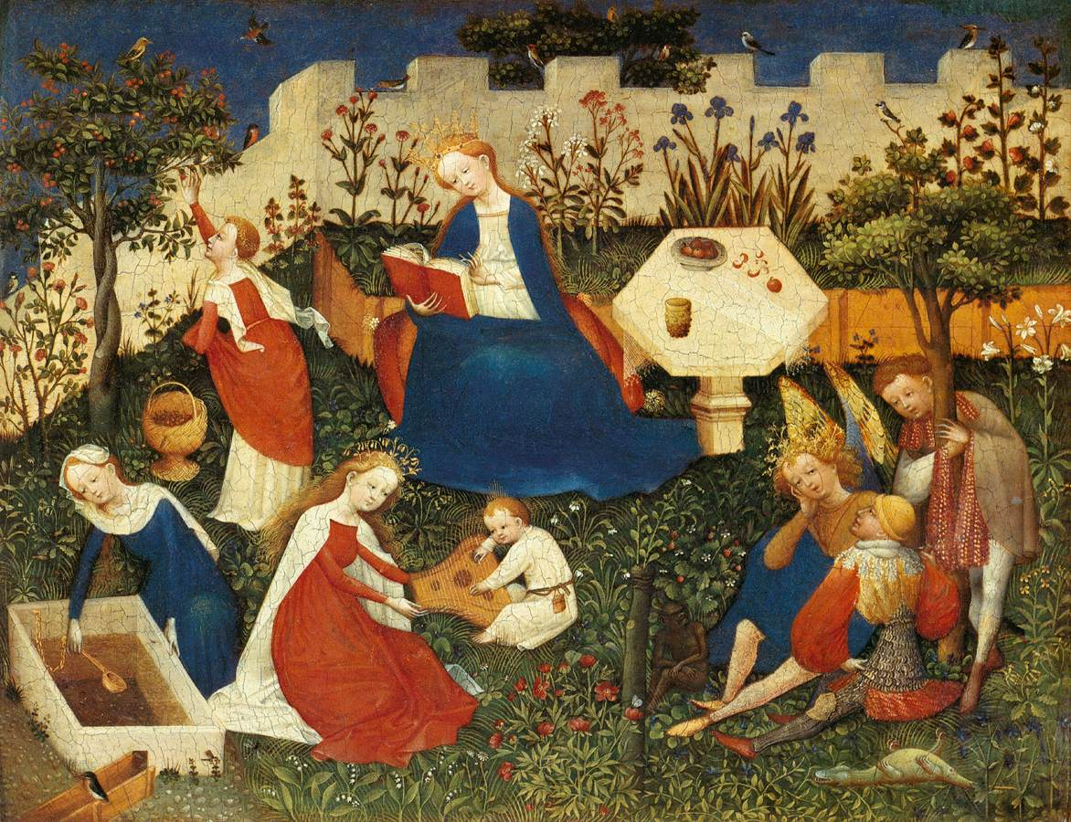

Slide 3
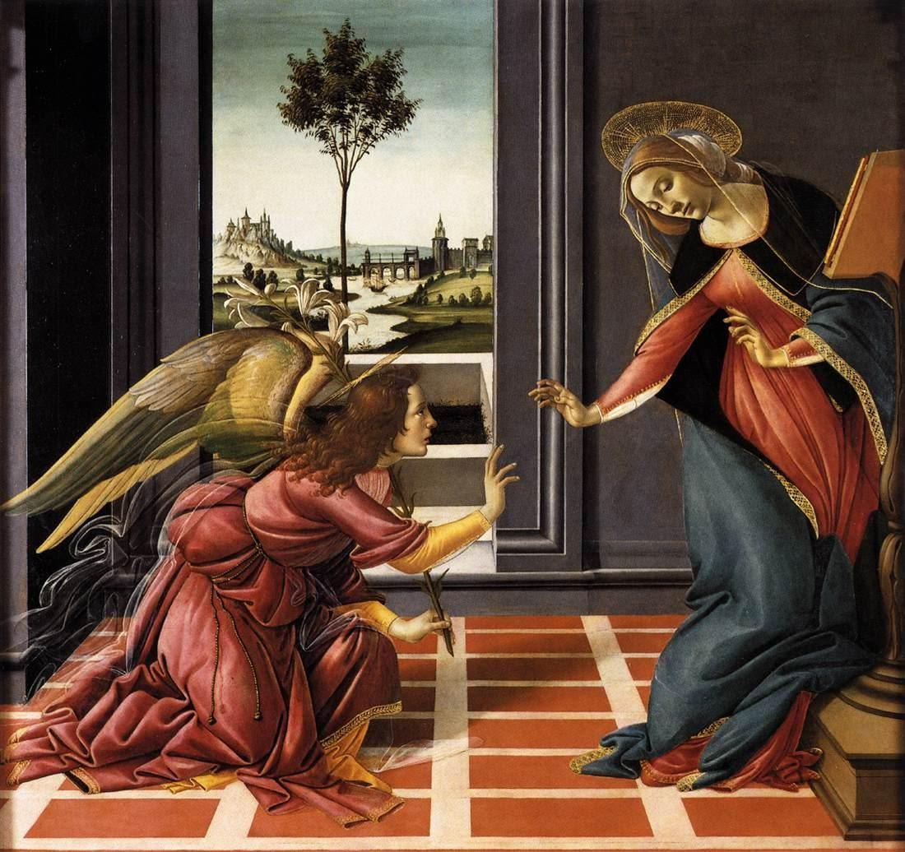
Annunciation. Sandro Boticelli, Tempera, 1489.

Slide 4
Annunciation. Sandro Boticelli, Tempera, 1489.

Slide 5
Annunciation. Sandro Boticelli, Tempera, 1489.

Slide 6
Annunciation. Sandro Boticelli, Tempera, 1489.

Slide 7
Annunciation. Sandro Boticelli, Tempera, 1489.

Slide 8
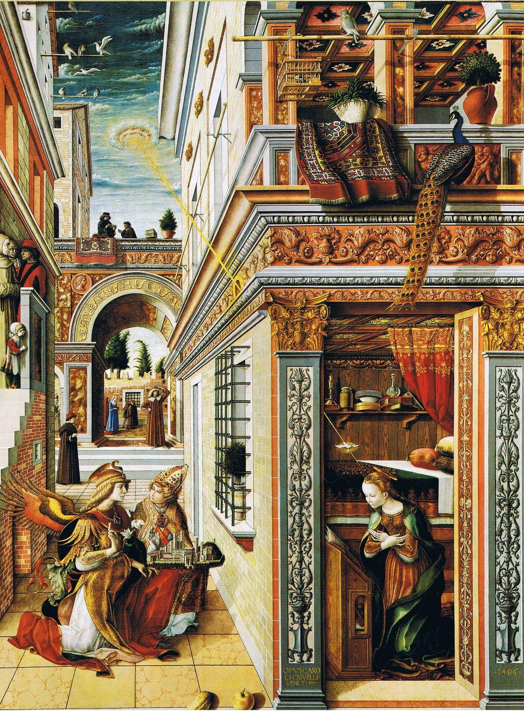
Annunciation with Saint Emidius, Carlo Crivelli, 1486.

Slide 9
Annunciation with Saint Emidius, Carlo Crivelli, 1486.

Slide 10
Annunciation with Saint Emidius, Carlo Crivelli, 1486.

Slide 11
Annunciation with Saint Emidius, Carlo Crivelli, 1486.

Slide 12
Annunciation with Saint Emidius, Carlo Crivelli, 1486.

Slide 13
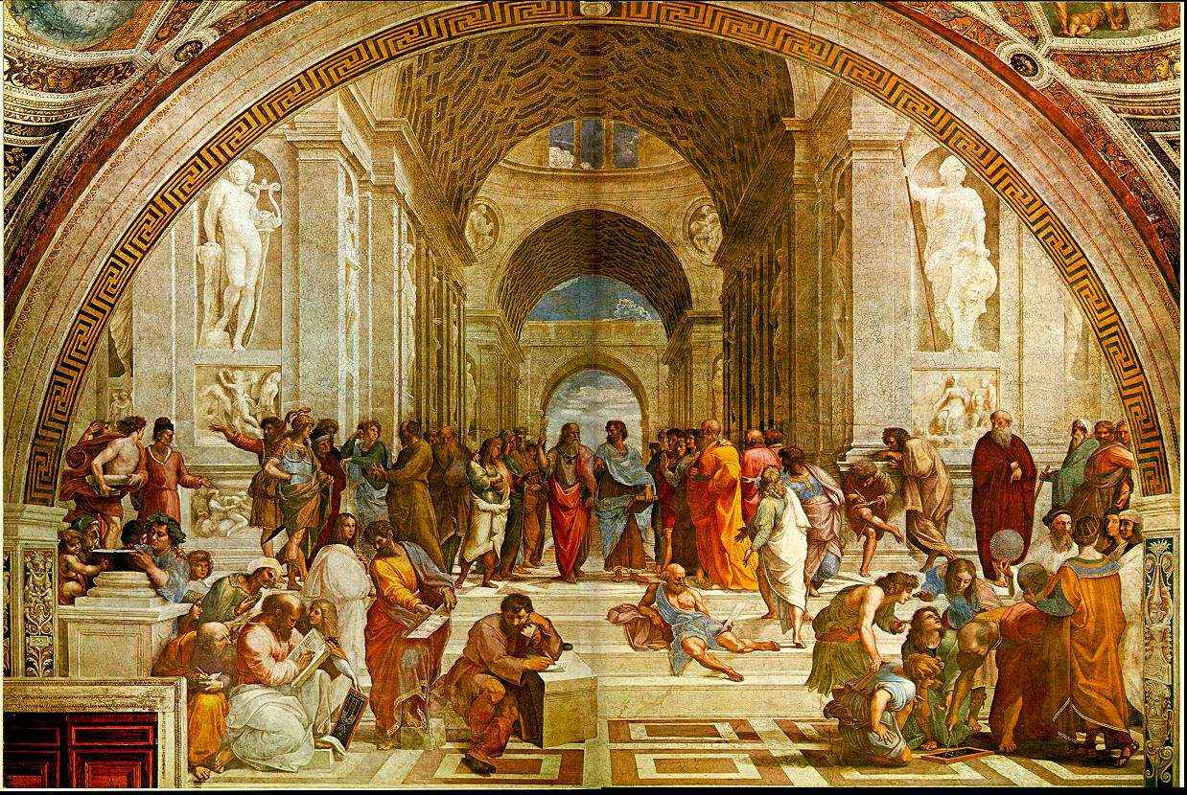
The School of Athens. Raphael, Fresco, 1510.

Slide 14
The School of Athens. Raphael, Fresco, 1510.

Slide 15
The School of Athens. Raphael, Fresco, 1510.

Slide 16
The School of Athens. Raphael, Fresco, 1510.

Slide 17
The School of Athens. Raphael, Fresco, 1510.

Slide 18
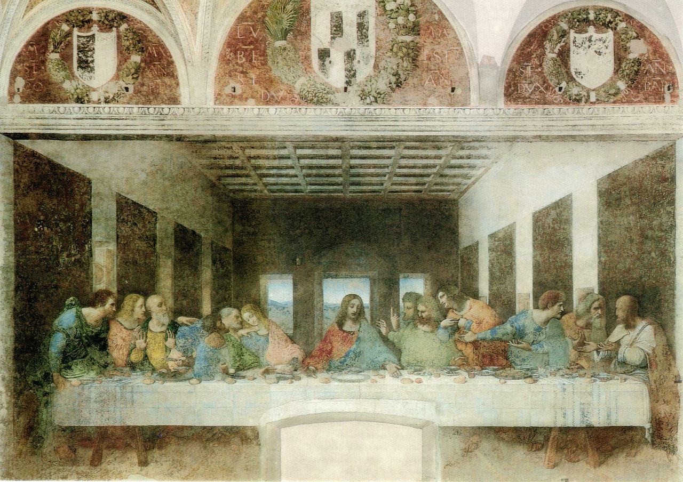
The Last Supper. Leonardo Da Vinci, Fresco, 1497

Slide 19
The Last Supper. Leonardo Da Vinci, Fresco, 1497

Slide 20
The Last Supper. Leonardo Da Vinci, Fresco, 1497

Slide 21
The Last Supper. Leonardo Da Vinci, Fresco, 1497

Slide 22
The Last Supper. Leonardo Da Vinci, Fresco, 1497

