Slide 1
Self Portraits

Slide 2
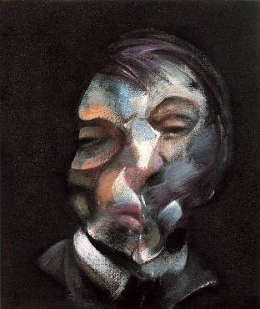
Francis Bacon Self Portrait

Slide 3
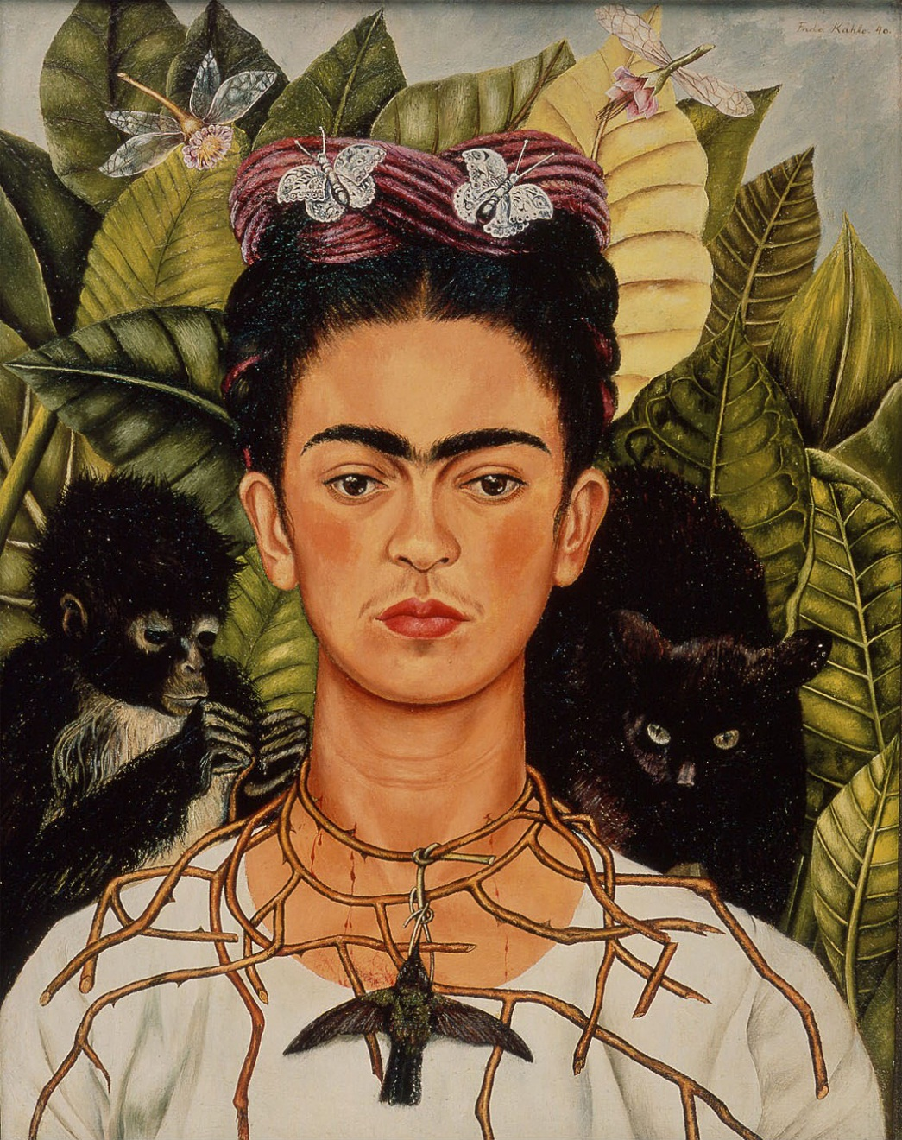
Frida Kahlo Self Portrait With Thorn Necklace

Slide 4
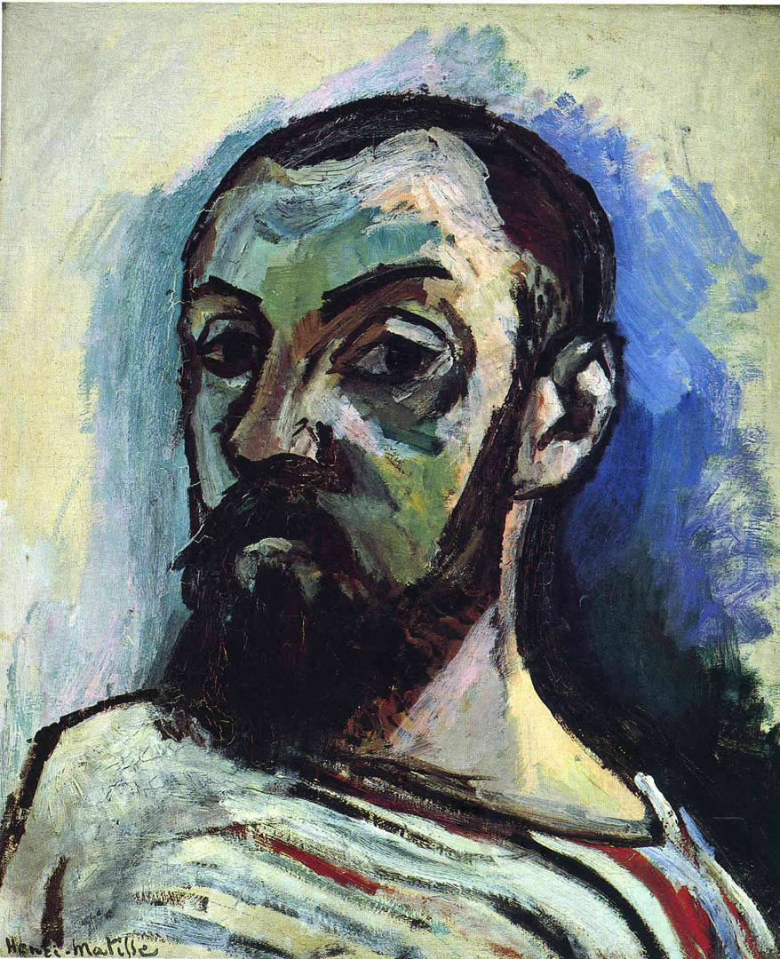
Henri Matisse Self Portrait When Young

Slide 5
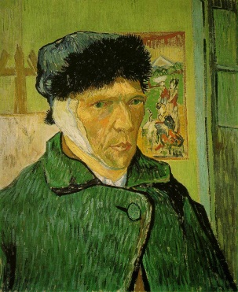
Van Gogh Self Portrait With Bandaged Ear

Slide 6
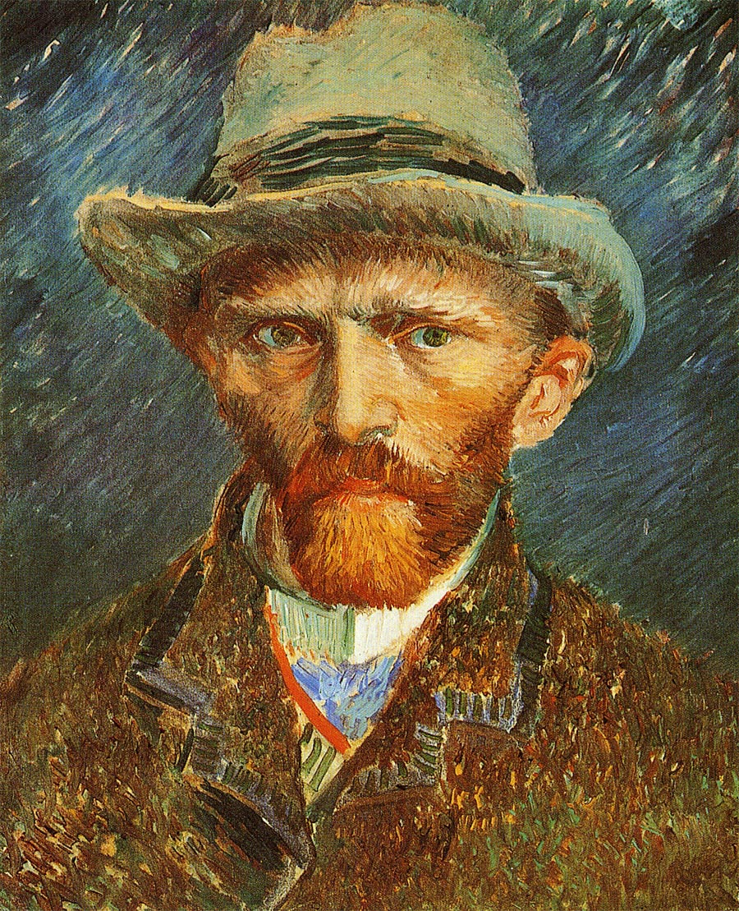
Van Gogh Self Portrait

Slide 7
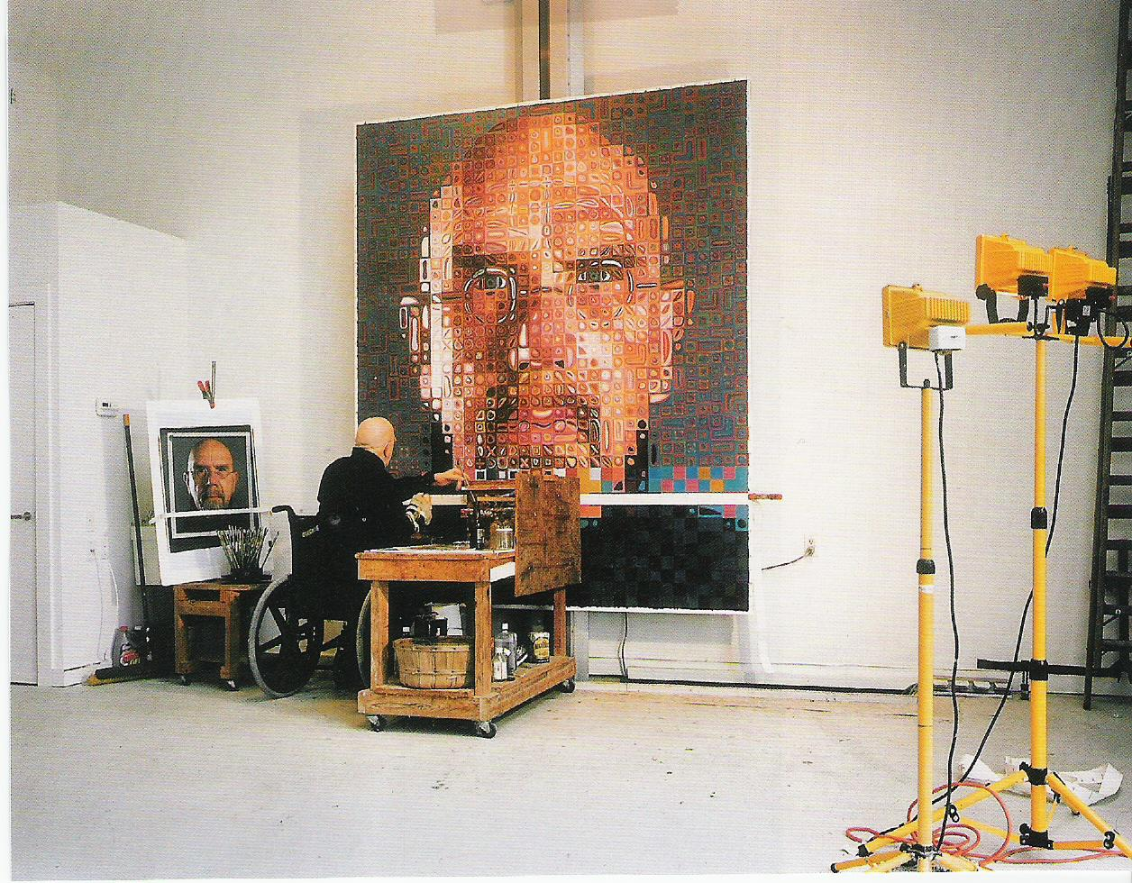
Chuck Close at work

Slide 8
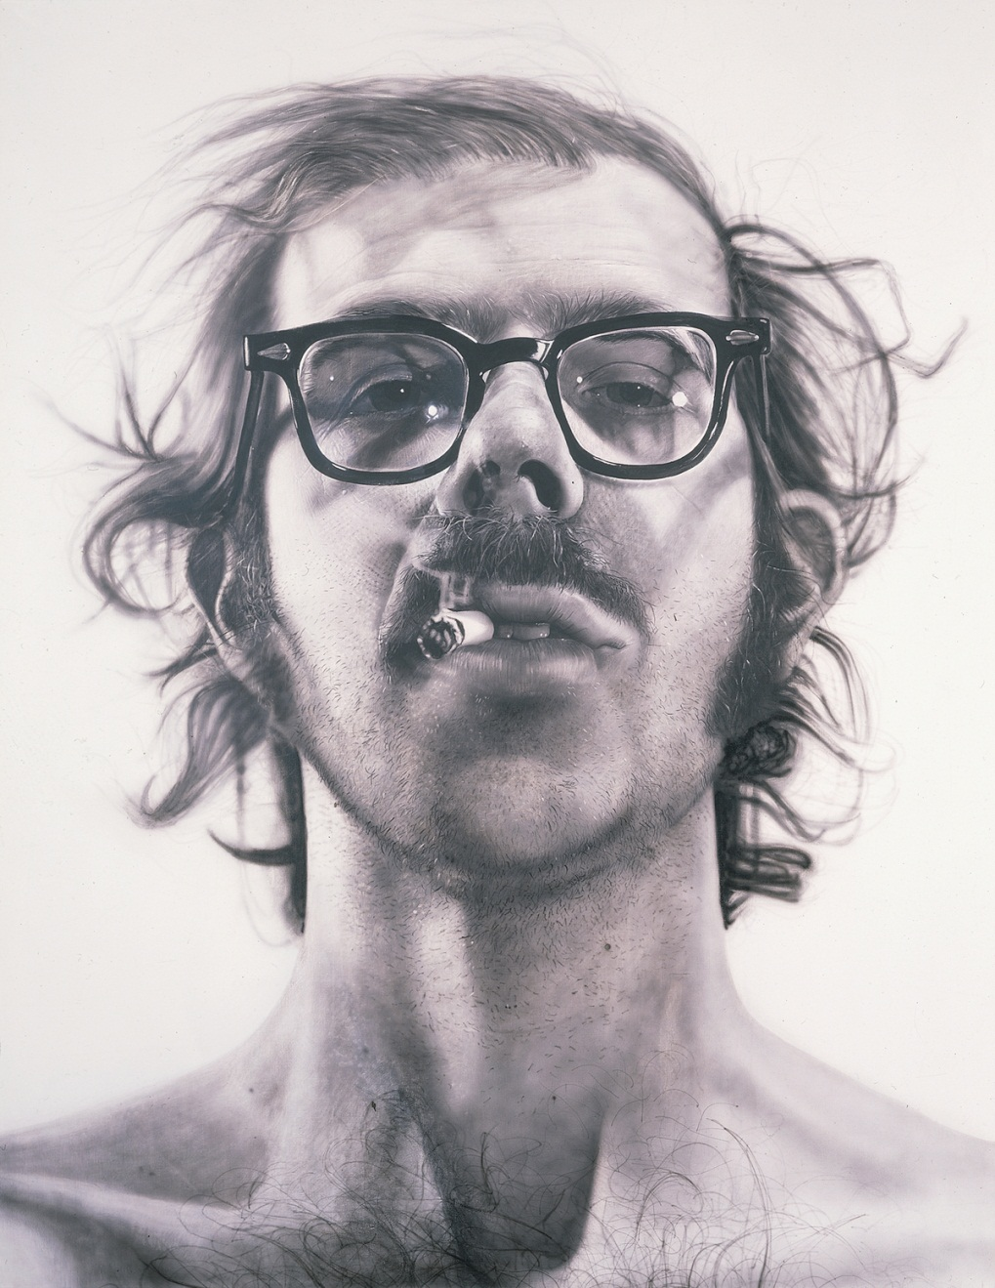
Chuck Close Big Self Portrait

Slide 9
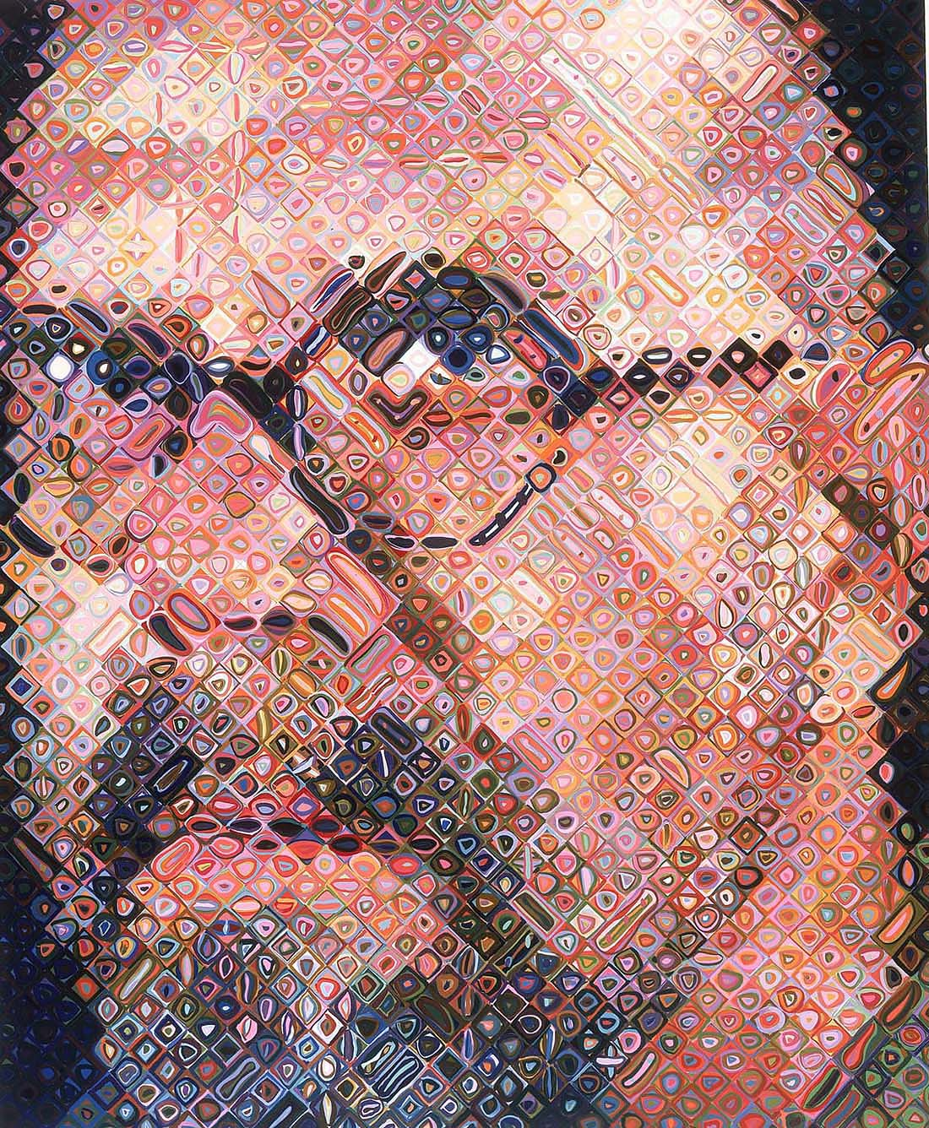
Chuck Close Self Portrait

Slide 10
Thanks!
Any Questions?

