Slide 1
Rhythm

Slide 2
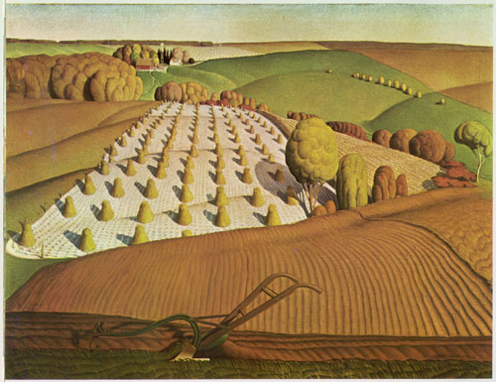
Grant Wood, Fall Ploughing 1931

Slide 3
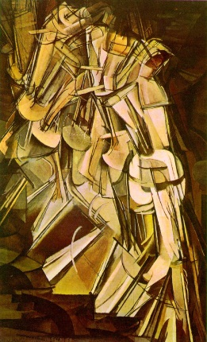
Marcel Duchamp, Nude Descending a Staircase

Slide 4
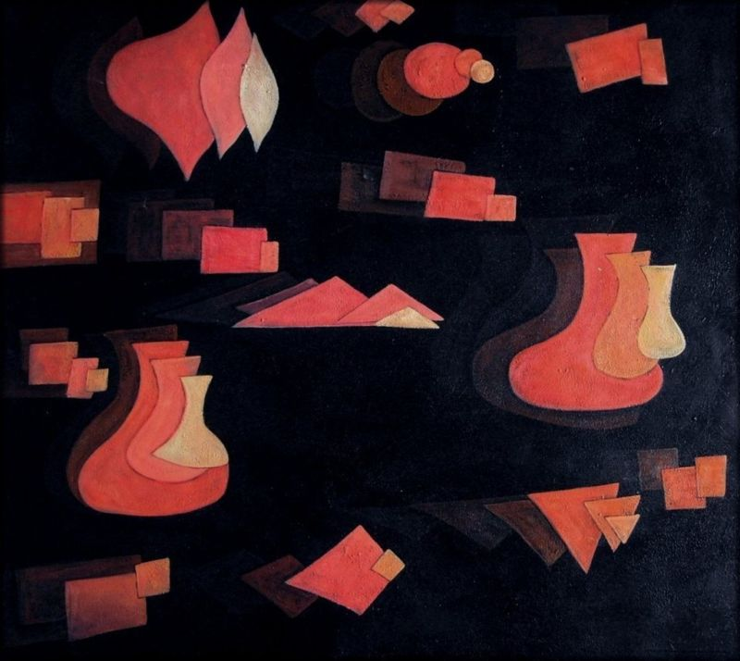
Paul Klee, Fugue in Red, 1921

Slide 5
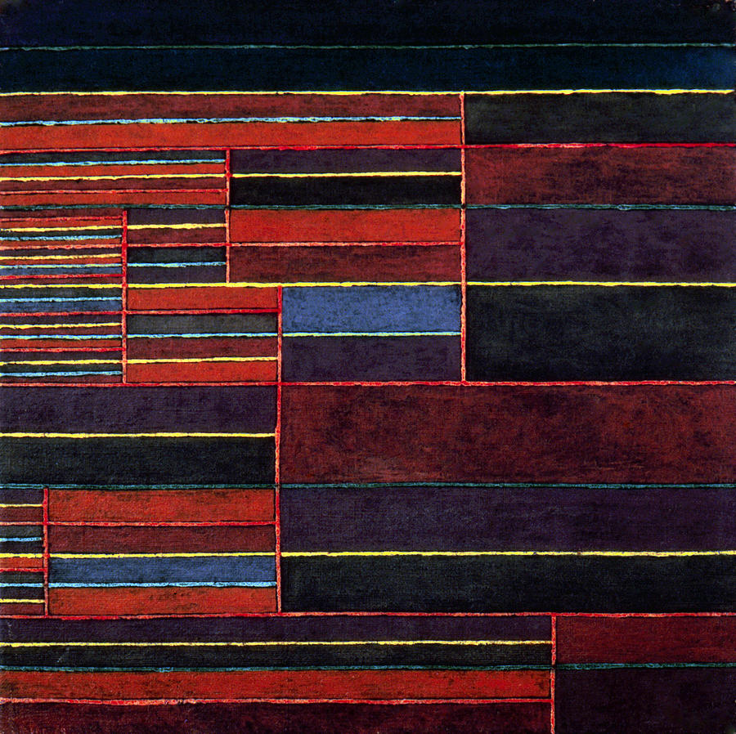
Paul Klee, Six Threshholds

Slide 6
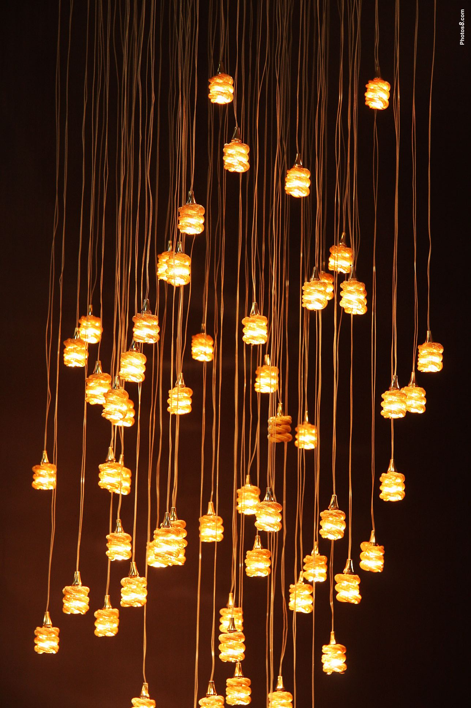
Rhythm in a Photograph

Slide 7
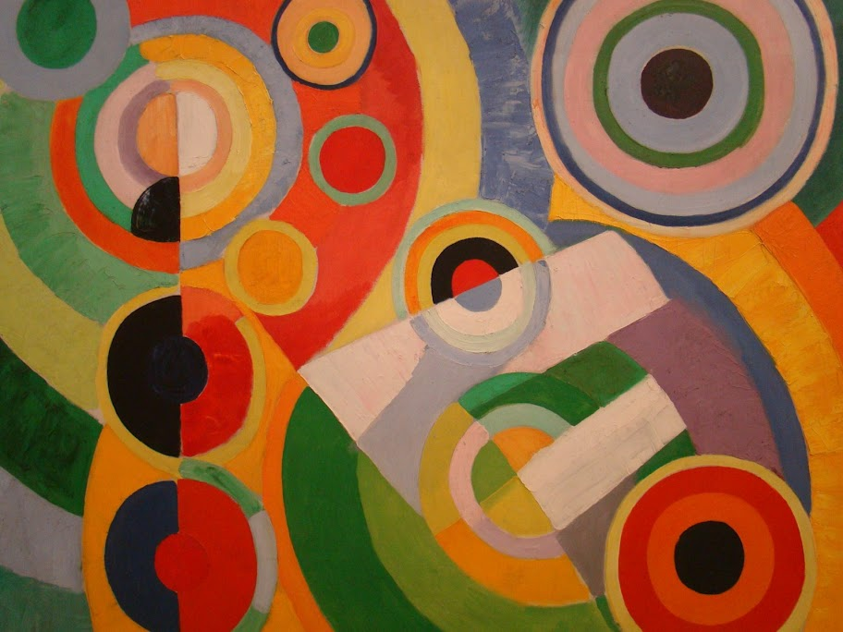
Robert Delaunay, Rhythm, Joie De Vivre

Slide 8
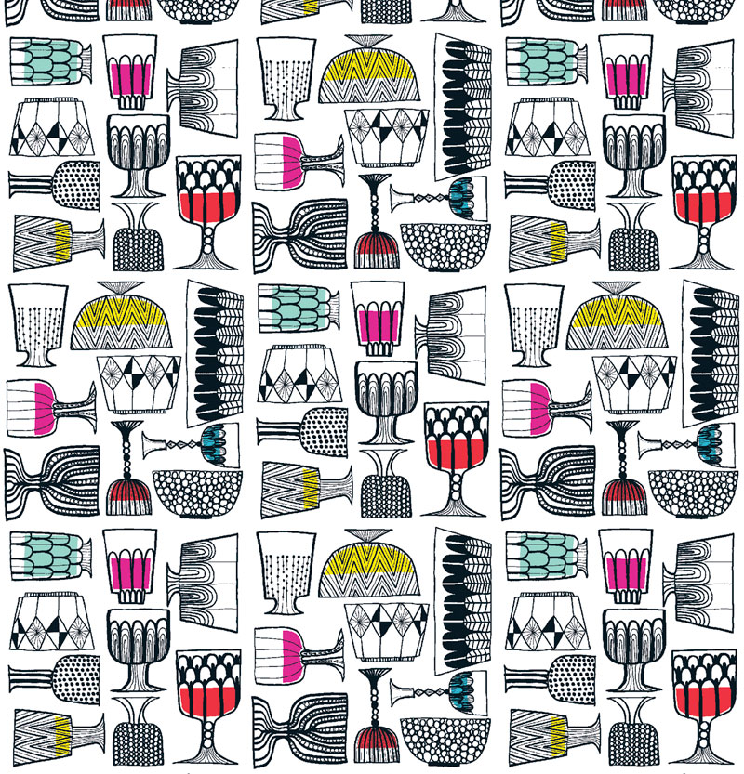
Marimekko Glasses

Slide 9
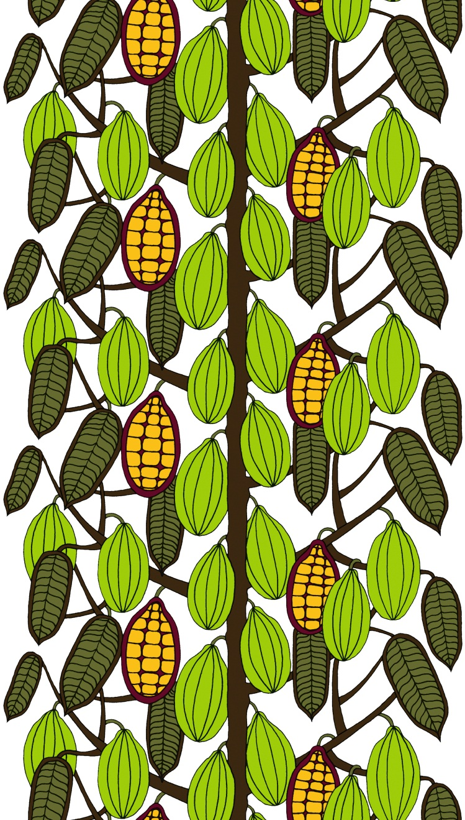
Marimekko Kaakaopuu

Slide 10
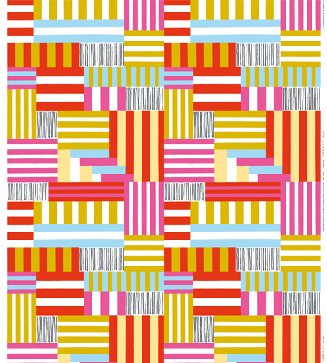
Marimekko Potpuri

Slide 11
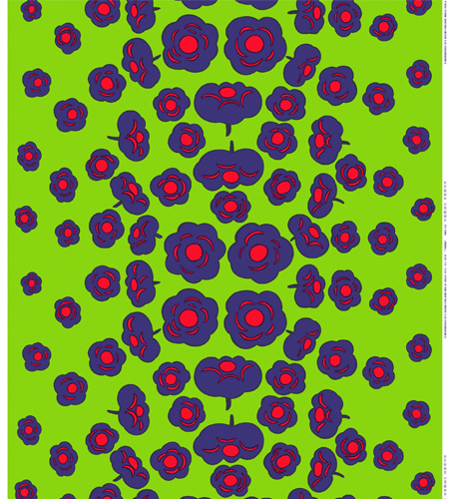
Marimekko Tuma

Slide 12
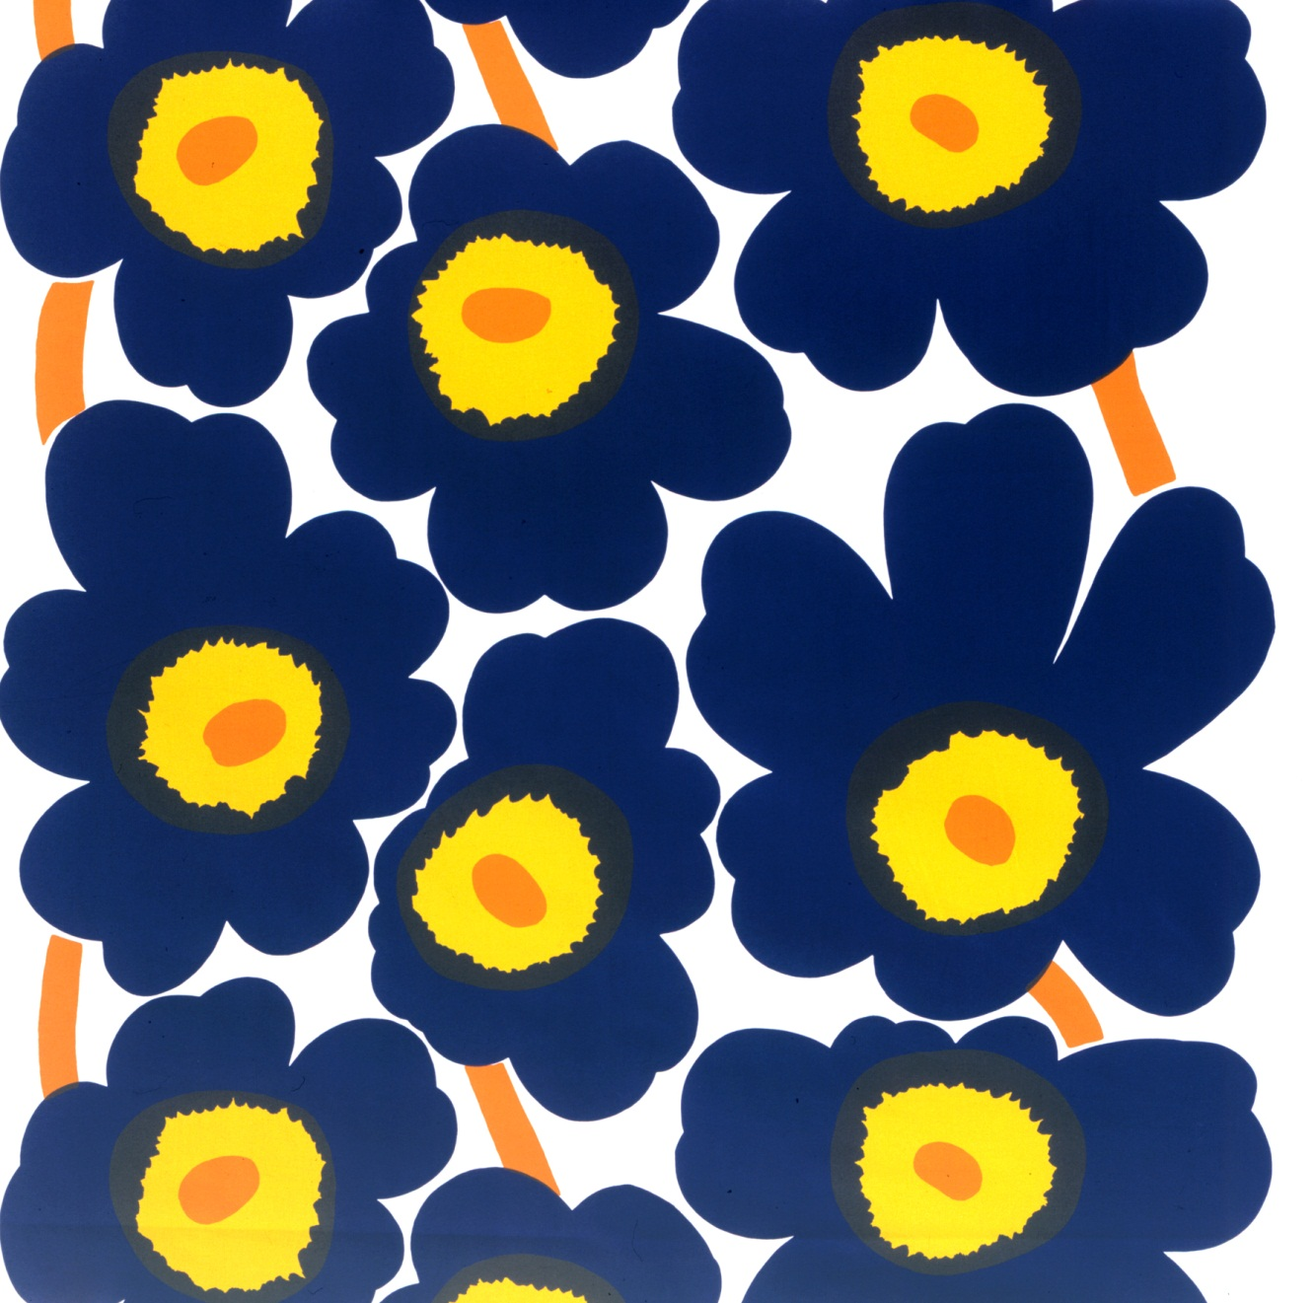
Marimekko Unikko (Poppy) Pattern

Slide 13
Marimekko

Slide 14
Thanks, any questions?

