Slide 1
Luchadores
Masked Mexican Wrestlers

Slide 2
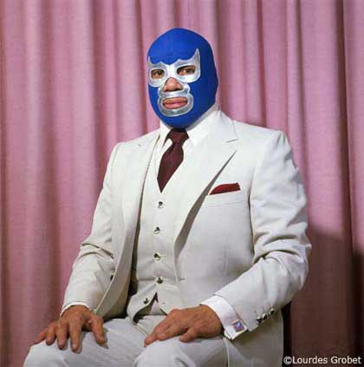
Blue Demon

Slide 3
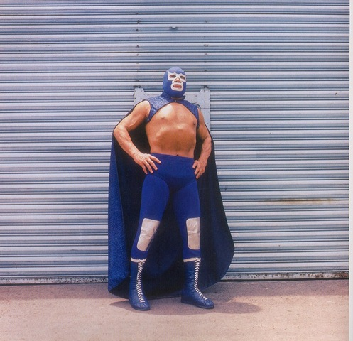
Blue Demon

Slide 4
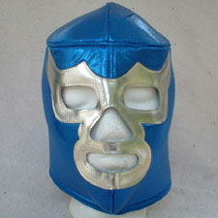
Blue Demon

Slide 5
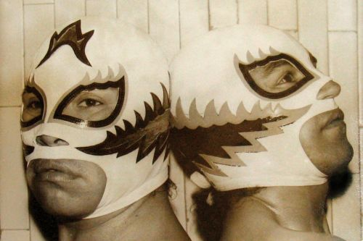
Dos Luchadores

Slide 6
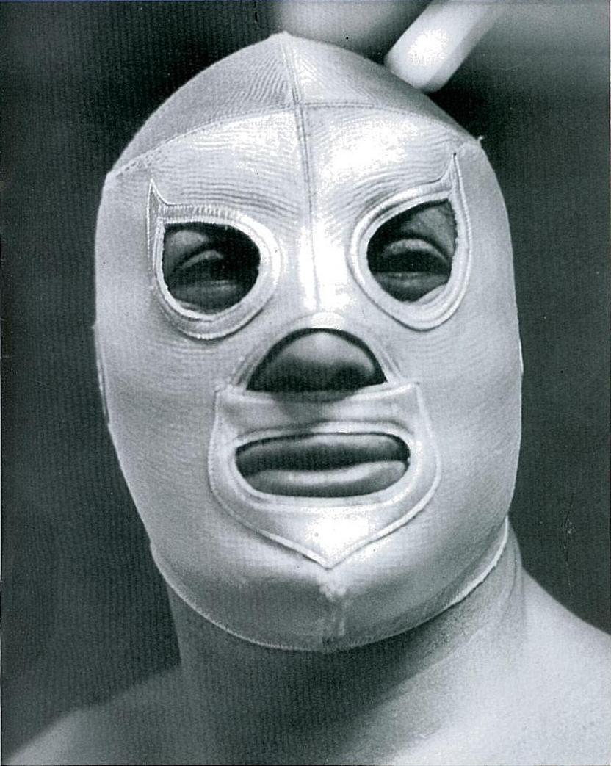
El Santo

Slide 7
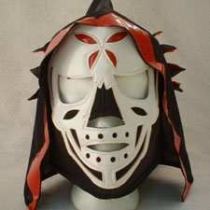
La Parka

Slide 8
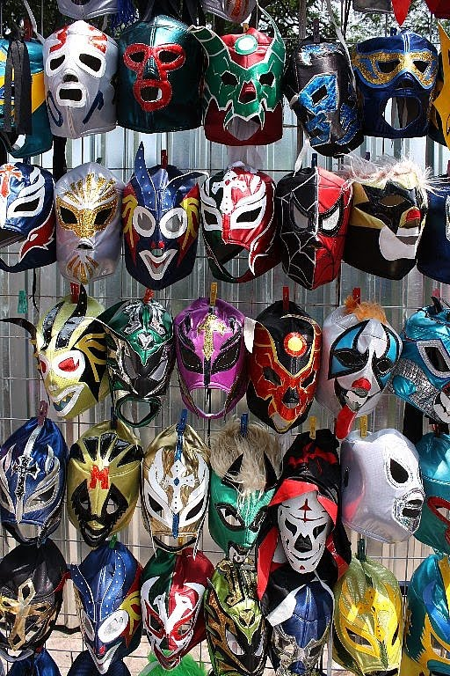
lucha libre masks

Slide 9
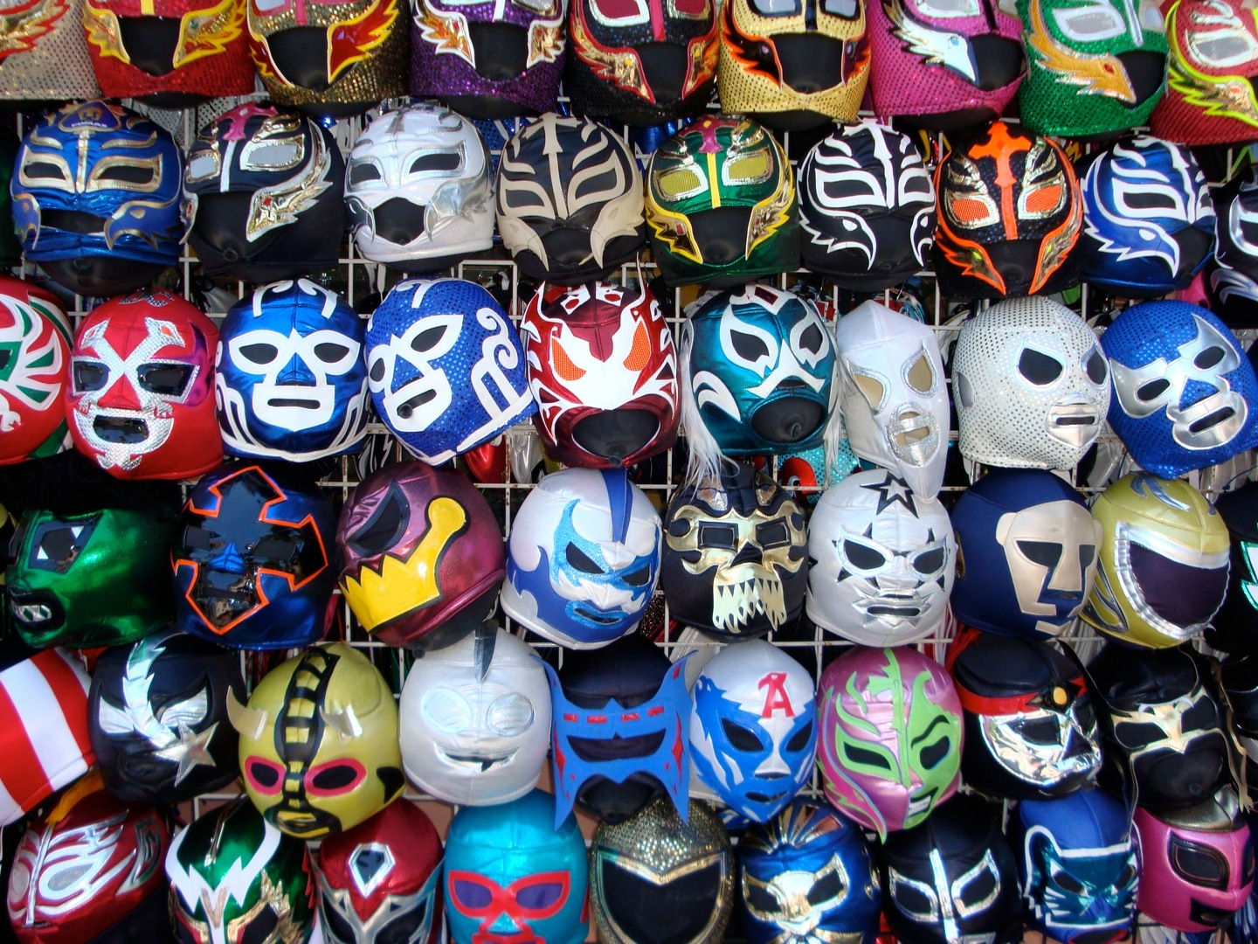
luchador masks

Slide 10
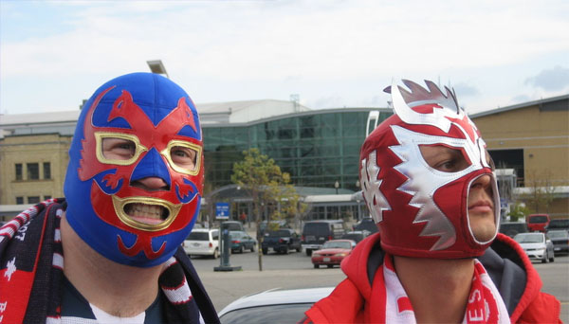
Luchadores

Slide 11
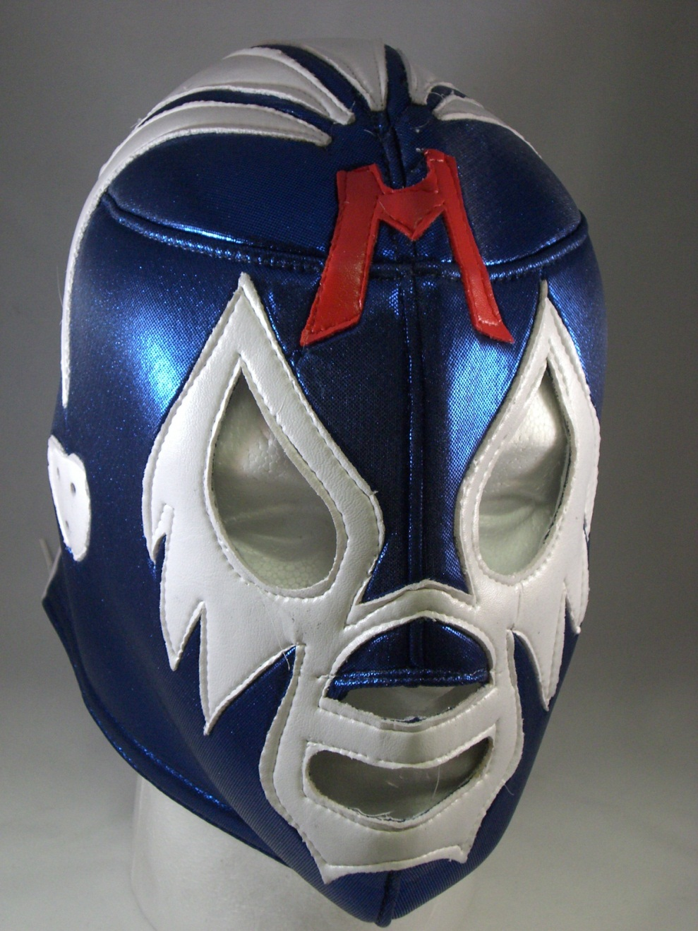

Slide 12
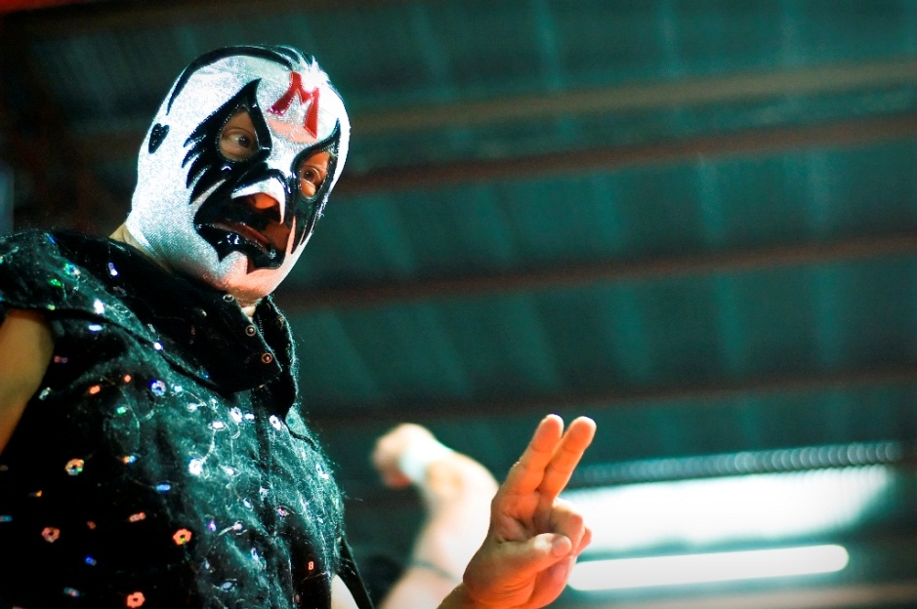
Mil Mascaras

Slide 13
blue
red
yellow
Notes:
Primary Colors

Slide 14
blue
purple
green
red
yellow
orange
Notes:
Secondary and Primary Colors

Slide 15
blue
orange
Notes:
Secondary and Primary Colors

Slide 16
green
red
Notes:
Complementary Colors

Slide 17
purple
yellow
Notes:
Secondary and Primary Colors

