Slide 1
Logos

Slide 2
Logos without letters

Slide 6
Logos with letters

Slide 11
Circular logos

Slide 18
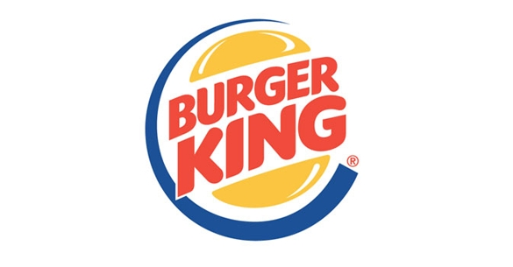

Slide 23
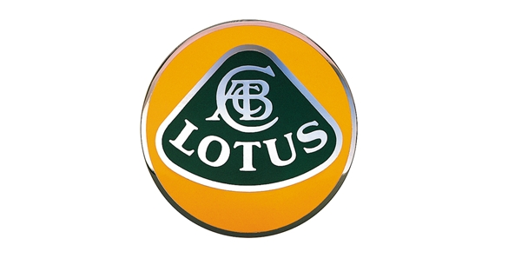

Slide 34
How will you represent your “brand”?

