Slide 1
Koichi Yamamoto Monoprints

Slide 2
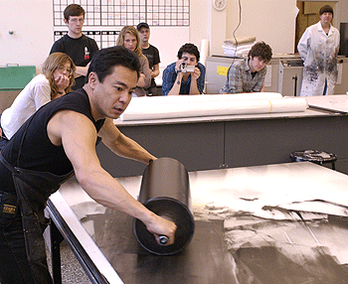
Koichi Yamamoto pulling a print at Island Press

Slide 3
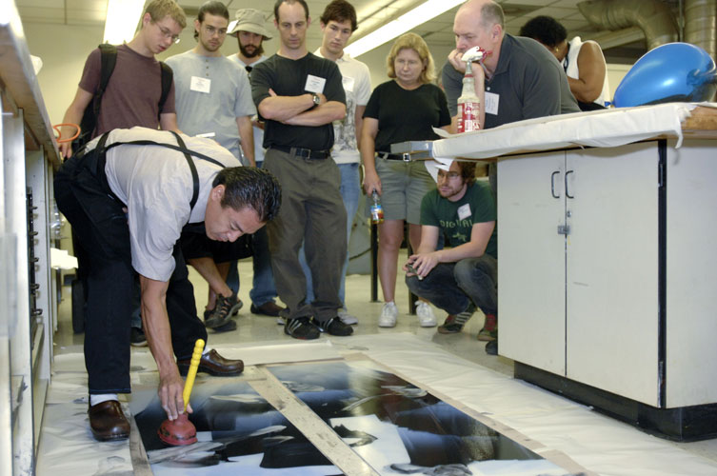
Koichi using a plunger to create arcs

Slide 4
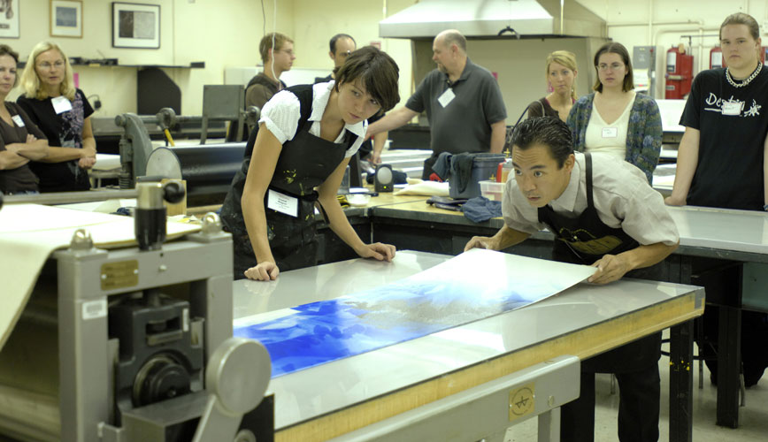
Lining up a plate on the press bed

Slide 5
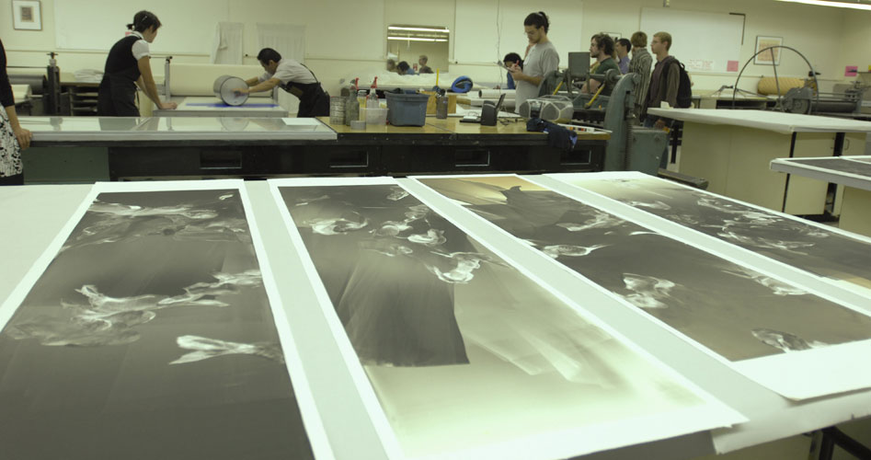
pulled prints, set to dry

Slide 6
Beni

Slide 7
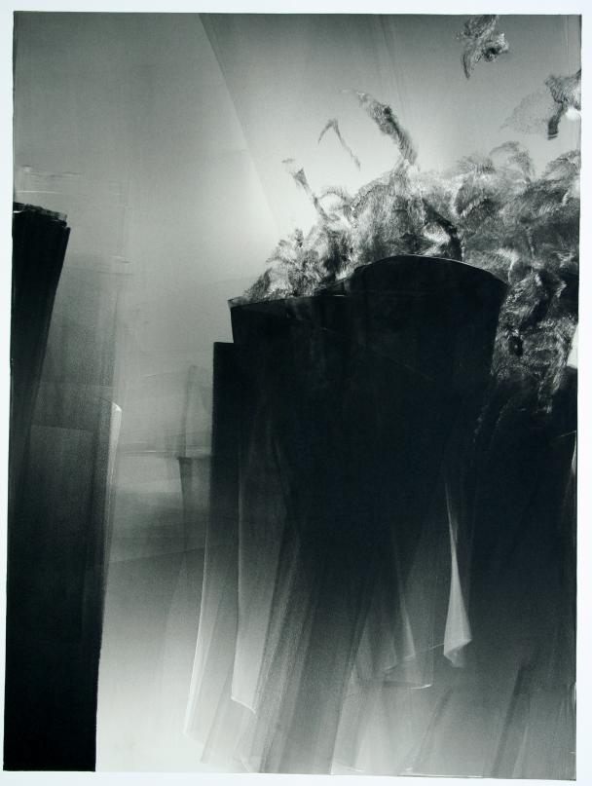
Ku Gate

Slide 8
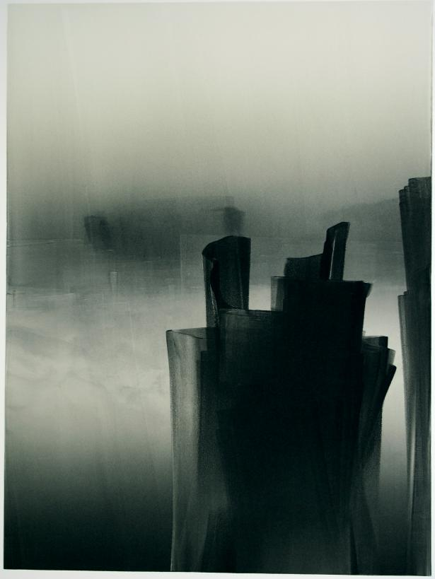
Kubi Sink

Slide 9
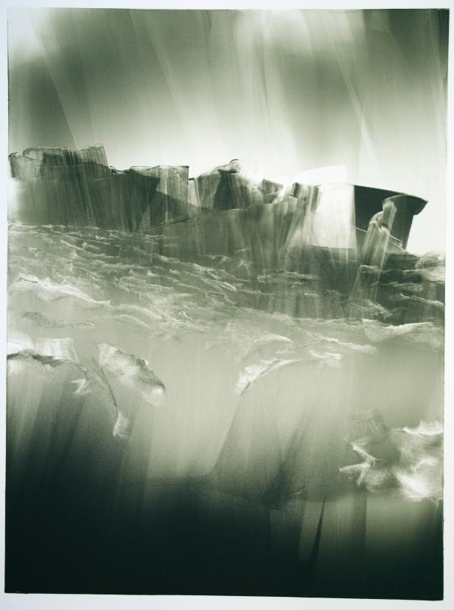
Kura Fat

Slide 10
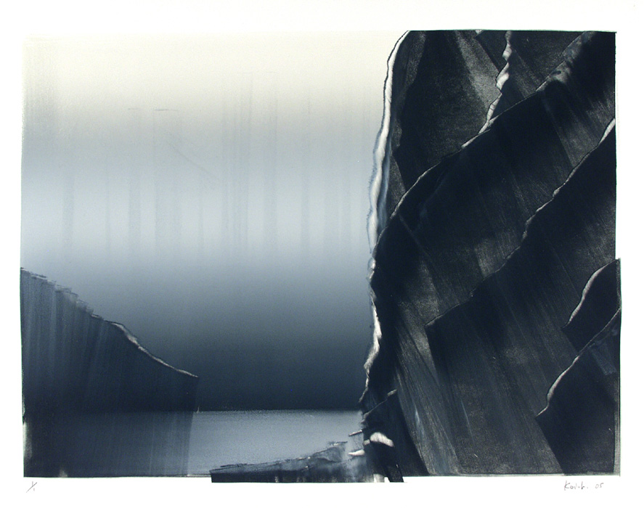
Untitled

Slide 11
Yaku Maru

