Slide 1
Ink Wash Landscapes

Slide 2
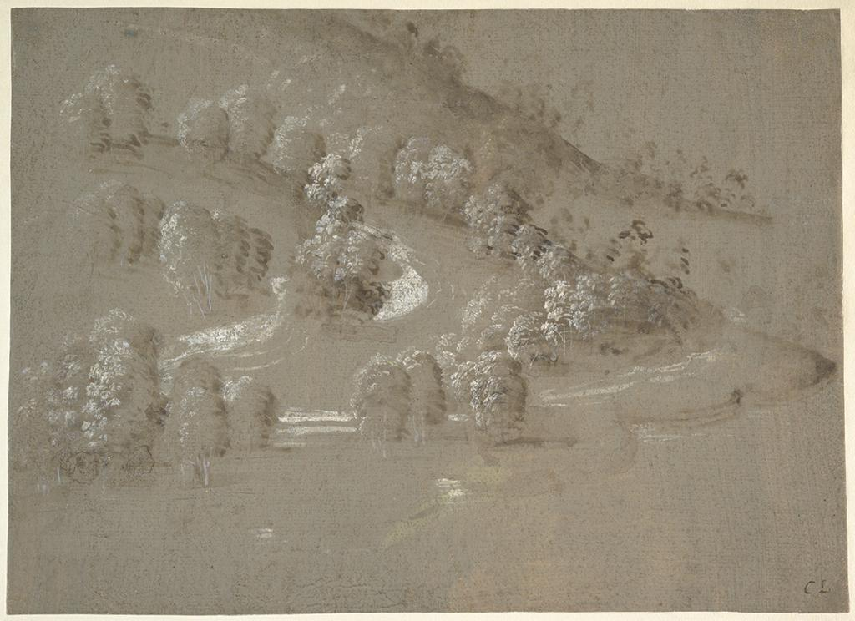
Notes:
Creator: Perugino (Pietro Vannucci), Italian, Città della Pieve ca. 1445/50-1523? Fontignano Culture: Italian Title: Landscape (recto); Landscape (verso) Title: Recto Date: 1489-1490 Material: Brush and brown wash, highlighted with white gouache, on gray-green prepared paper (recto); pen and brown ink (verso) Measurements: 8 x 11-1/16 in. (20.4 x 28 cm.) Description: Annotated in pen and brown ink, at lower right corner, "CL", possibly referring to Claude Lorrain. Repository: The Metropolitan Museum of Art Repository: http://www.metmuseum.org Collection: Metropolitan Museum of Art - Images for Academic Publishing ID Number: 7586 Source: Data From: The Metropolitan Museum of Art Credit Line: The Metropolitan Museum of Art, Purchase, Lila Acheson Wallace Gift, 1993 (1993.327) Image Copyright Notice: Image © The Metropolitan Museum of Art Rights: This image was provided by The Metropolitan Museum of Art. Contact information: Image Library, The Metropolitan Museum of Art, 1000 Fifth Avenue, New York, NY 10028, (212) 396-5050 (fax), Scholars.License@MetMuseum.org Rights: Image © The Metropolitan Museum of Art Rights: This image is available for uses permitted under the ARTstor Terms and Conditions of Use, such as teaching and study, as well as for scholarly publications, through the Images for Academic Publishing (IAP) initiative. If you are seeking to use this image for scholarly publication, you should click on the IAP icon below the thumbnail image.

Slide 3
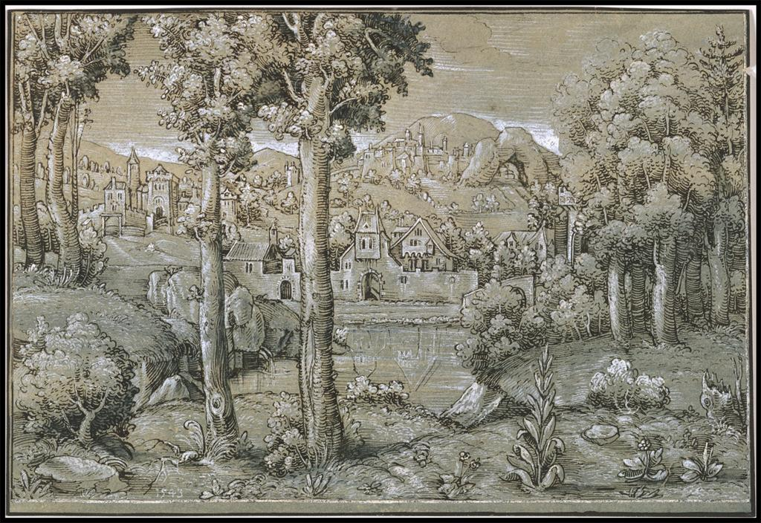
Notes:
Creator: Hanns Lautensack, Bamberg (?)ca. 1520 - Vienna 1564/66 Title: Imaginary Landscape Date: 1543 Material: Pen and dark brown ink and brush and grayish blue watercolor, washed in blue, heightened with brush and opaque white, on greenish blue prepared paper. Measurements: 5 11/16 x 8 3/8 in. (14.4 x 21.3 cm) Description: Inscribed in white at lower left: 1543 Repository: The Metropolitan Museum of Art Repository: http://www.metmuseum.org Collection: Metropolitan Museum of Art - Images for Academic Publishing ID Number: 328 Source: Data From: The Metropolitan Museum of Art Credit Line: The Metropolitan Museum of Art, Robert Lehman Collection, 1975 (1975.1.864) Image Copyright Notice: Image © The Metropolitan Museum of Art Rights: This image was provided by The Metropolitan Museum of Art. Contact information: Image Library, The Metropolitan Museum of Art, 1000 Fifth Avenue, New York, NY 10028, (212) 396-5050 (fax), Scholars.License@MetMuseum.org Rights: Image © The Metropolitan Museum of Art Rights: This image is available for uses permitted under the ARTstor Terms and Conditions of Use, such as teaching and study, as well as for scholarly publications, through the Images for Academic Publishing (IAP) initiative. If you are seeking to use this image for scholarly publication, you should click on the IAP icon below the thumbnail image.

Slide 4
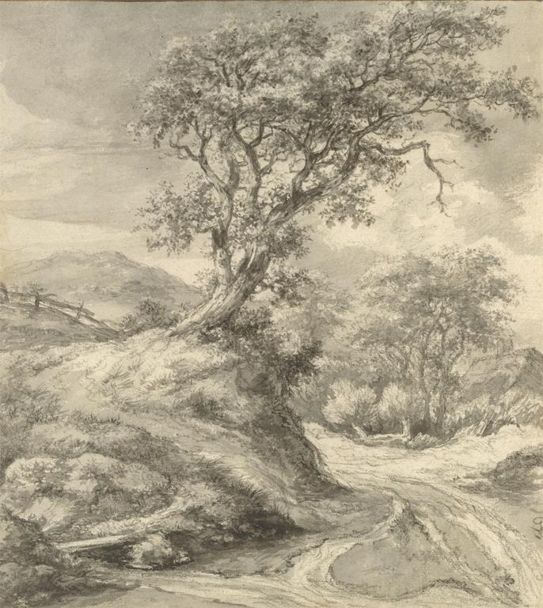
Notes:
Creator: Jacob van Ruisdael, Dutch, Haarlem 1628/29 - 1682 Amsterdam Culture: Dutch Title: Dune Landscape with Oak Tree Date: 1650-55 Material: Black chalk; brush and gray wash; gouache; framing lines in pen and brown ink. Measurements: 8 1/4 x 7 1/2 in. (21.0 x 19.1 cm) Description: [in black chalk at lower right]: JvR [interlaced]. Description: [on verso at lower left in pencil]: J.d.V. / SR xoo. Description: verso lower left collectors' mark of A. Sträter Repository: The Metropolitan Museum of Art Repository: http://www.metmuseum.org Collection: Metropolitan Museum of Art - Images for Academic Publishing ID Number: 4532 Source: Data From: The Metropolitan Museum of Art Credit Line: The Metropolitan Museum of Art, Fletcher Fund, 1995 (1995.196) Image Copyright Notice: Image © The Metropolitan Museum of Art Rights: This image was provided by The Metropolitan Museum of Art. Contact information: Image Library, The Metropolitan Museum of Art, 1000 Fifth Avenue, New York, NY 10028, (212) 396-5050 (fax), Scholars.License@MetMuseum.org Rights: Image © The Metropolitan Museum of Art Rights: This image is available for uses permitted under the ARTstor Terms and Conditions of Use, such as teaching and study, as well as for scholarly publications, through the Images for Academic Publishing (IAP) initiative. If you are seeking to use this image for scholarly publication, you should click on the IAP icon below the thumbnail image.

Slide 5
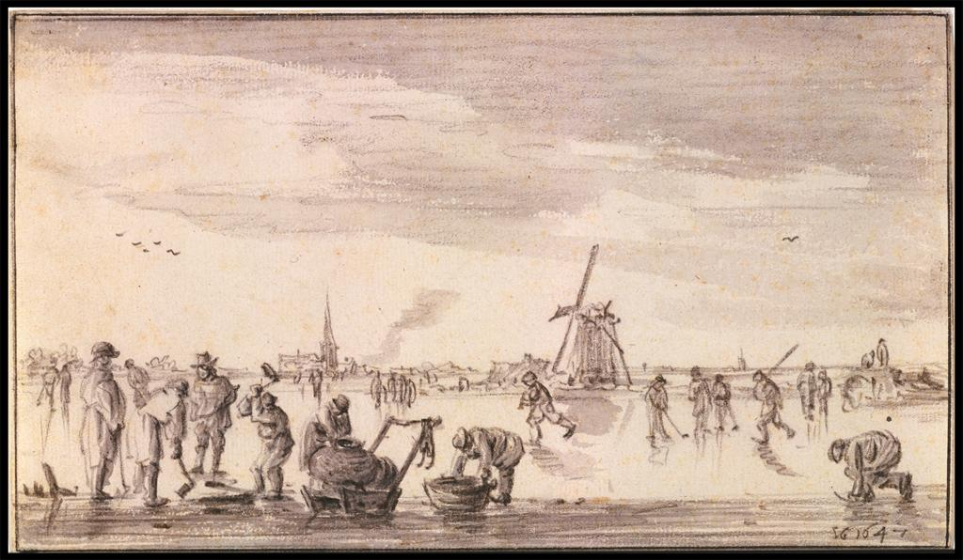
Notes:
Creator: Jan van Goyen, Leiden 1596 - The Hague 1656 Title: Winter Landscape with Skaters and Fishermen Date: 1647 Material: Black chalk with gray wash; two framing lines, the first in brush and gray ink by Van Goyen himself, the second in pen and dark brown ink added later. Measurements: 4 7/16 x 7 11/16 in. (11.3 x 19.5 cm) Description: Signed and dated at bottom right: VG 1647 Description: Watermark: fleur de lys in a crowned shield with the letters LR under it. Annotated on the verso in pencil: GN (probably Gustav Nebehay) Repository: The Metropolitan Museum of Art Repository: http://www.metmuseum.org Collection: Metropolitan Museum of Art - Images for Academic Publishing ID Number: 359 Source: Data From: The Metropolitan Museum of Art Credit Line: The Metropolitan Museum of Art, Robert Lehman Collection, 1975 (1975.1.779) Image Copyright Notice: Image © The Metropolitan Museum of Art Rights: This image was provided by The Metropolitan Museum of Art. Contact information: Image Library, The Metropolitan Museum of Art, 1000 Fifth Avenue, New York, NY 10028, (212) 396-5050 (fax), Scholars.License@MetMuseum.org Rights: Image © The Metropolitan Museum of Art Rights: This image is available for uses permitted under the ARTstor Terms and Conditions of Use, such as teaching and study, as well as for scholarly publications, through the Images for Academic Publishing (IAP) initiative. If you are seeking to use this image for scholarly publication, you should click on the IAP icon below the thumbnail image.

Slide 6
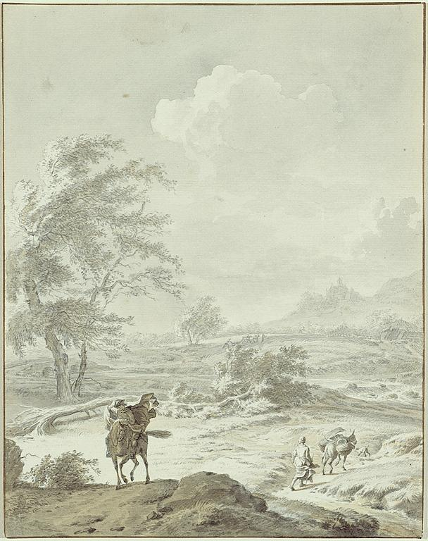
Notes:
Creator: Dirk Maas, European; Dutch, 1659-1717 Title: Landscape with Man on Horseback and Woman Guiding a Donkey Work Type: Drawings and Watercolors Date: late 17th/early 18th Century Material: Black chalk and brush and gray ink and gray and ocher wash on buff laid paper Measurements: 29 cm x 22.5 cm Description: Full View Repository: The Detroit Institute of Arts Repository: Detroit, Michigan, USA Repository: Founders Society Purchase, William H. Murphy Fund Repository: 34.99 Repository: http://www.dia.org/ Collection: Detroit Institute of Arts Collection Collection: Formerly in The AMICO Library ID Number: DIA_.34.99 Source: Data from: The Detroit Institute of Arts Rights: This image was provided by The Detroit Institute of Arts. Contact Info for Permissions: Sylvia Inwood, Manager, Rights and Reproduction, The Detroit Institute of Arts, 5200 Woodward Ave., Detroit, MI 48202, 313-833-7913, 313-833-9161, rhensleigh@dia.org Rights: Please note that if this image is under copyright, you may need to contact one or more copyright owners for any use that is not permitted under the ARTstor Terms and Conditions of Use or not otherwise permitted by law. While ARTstor tries to update contact information, it cannot guarantee that such information is always accurate. Determining whether those permissions are necessary, and obtaining such permissions, is your sole responsibility.

Slide 7
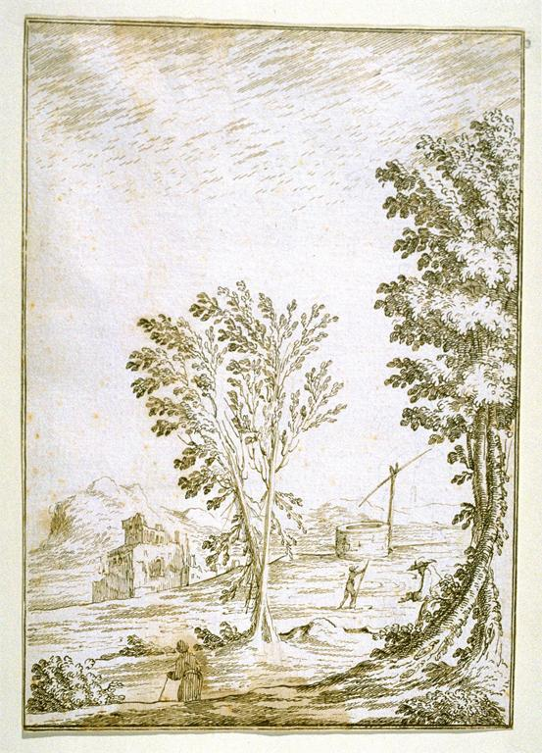
Notes:
Creator: Giuseppe Santini, European; Southern European; Italian, 1610 - 1664 Title: Landscape with Trees, a Well, and a Ruined Castle Work Type: Drawings and Watercolors Date: 17th century Material: pen and brown ink over black chalk underdrawing on cream laid paper Measurements: 23.1 x 16.4 cm Repository: Fine Arts Museums of San Francisco Repository: San Francisco, California, USA Repository: Achenbach Foundation for Graphic Arts purchase, Georges de Batz Collection Repository: 1967.17.30 Repository: http://www.thinker.org/ Collection: Fine Arts Museums of San Francisco Collection Collection: Formerly in The AMICO Library ID Number: FASF.57840 Source: Data From: Fine Arts Museums of San Francisco Rights: This image was provided by Fine Arts Museums of San Francisco. Contact information: Sue Grinols, Director of Photo Services & Imaging, Fine Arts Museums of San Francisco, 50 Hagiwara Tea Garden Drive, Golden Gate Park, San Francisco, CA 94118-4501, (415) 750-3602 (ph), (415) 750-7686 (fax), sgrinols@famsf.org. Rights: Please note that if this image is under copyright, you may need to contact one or more copyright owners for any use that is not permitted under the ARTstor Terms and Conditions of Use or not otherwise permitted by law. While ARTstor tries to update contact information, it cannot guarantee that such information is always accurate. Determining whether those permissions are necessary, and obtaining such permissions, is your sole responsibility.

Slide 8
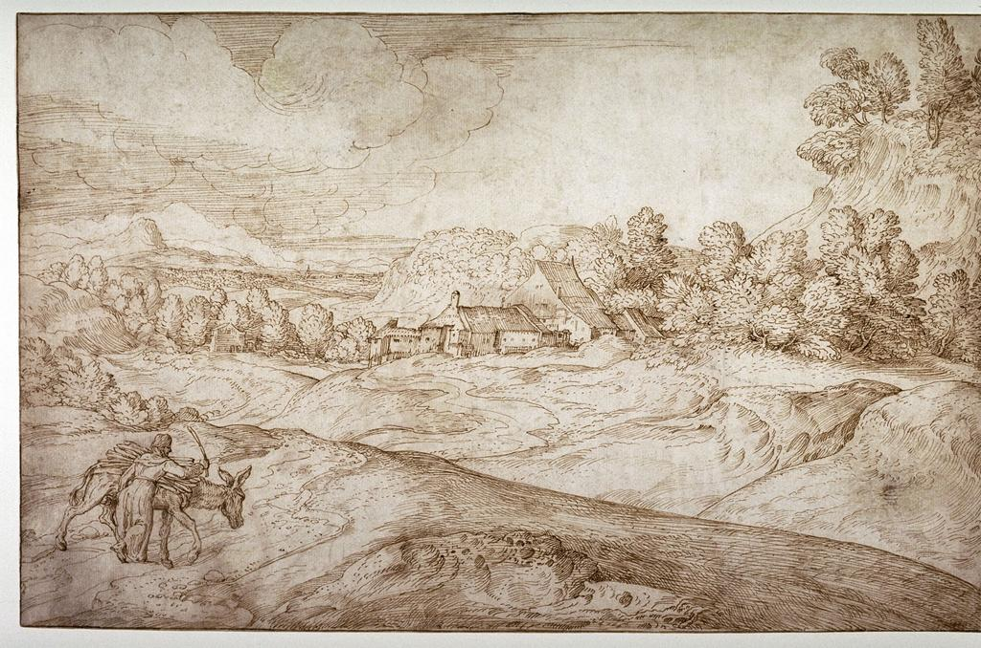
Notes:
Creator: Domenico Campagnola, European; Southern European; Italian, 1500 - 1564 Title: Hilly Landscape with Woman and Donkey Work Type: Drawings and Watercolors Work Type: Landscape Date: 16th century Material: Pen and brown ink on laid paper Measurements: 24.8 x 38.2 cm (sheet) Repository: Fine Arts Museums of San Francisco Repository: San Francisco, California, USA Repository: Achenbach Foundation for Graphic Arts purchase Repository: 1984.2.39 Repository: http://www.thinker.org/ Collection: Fine Arts Museums of San Francisco Collection Collection: Formerly in The AMICO Library ID Number: FASF.60585 Source: Data From: Fine Arts Museums of San Francisco Rights: This image was provided by Fine Arts Museums of San Francisco. Contact information: Sue Grinols, Director of Photo Services & Imaging, Fine Arts Museums of San Francisco, 50 Hagiwara Tea Garden Drive, Golden Gate Park, San Francisco, CA 94118-4501, (415) 750-3602 (ph), (415) 750-7686 (fax), sgrinols@famsf.org. Rights: Please note that if this image is under copyright, you may need to contact one or more copyright owners for any use that is not permitted under the ARTstor Terms and Conditions of Use or not otherwise permitted by law. While ARTstor tries to update contact information, it cannot guarantee that such information is always accurate. Determining whether those permissions are necessary, and obtaining such permissions, is your sole responsibility.

Slide 9
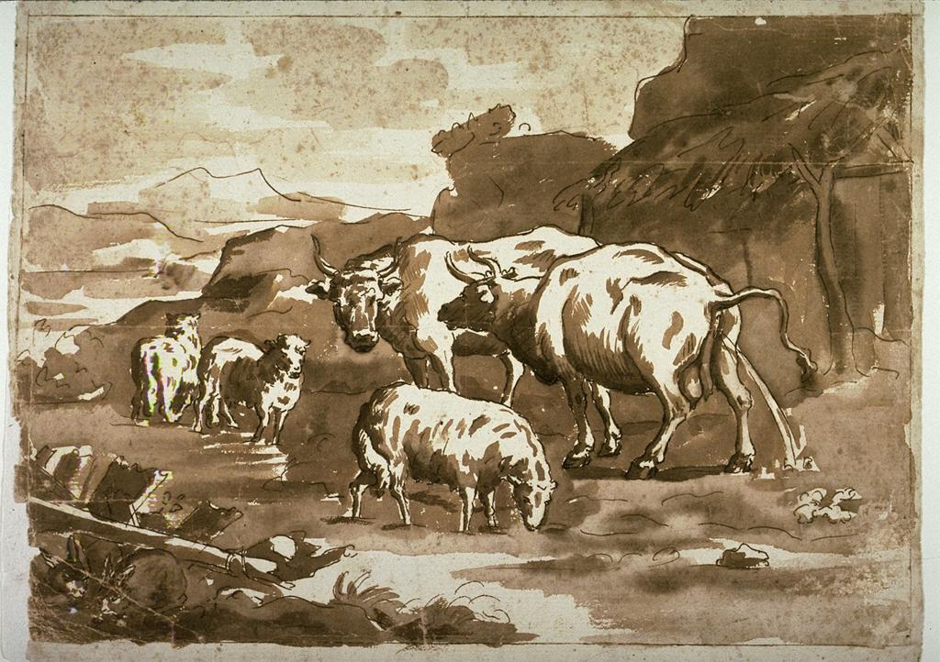
Notes:
Creator: Domenico Brandi, European; Southern European; Italian, 1683 - 1736 Title: Cows and Sheep Work Type: Drawings and Watercolors Work Type: Animal Work Type: Landscape Date: 17th - 18th century Material: Pen and brown ink and brown wash over traces of red chalk on laid paper mounted to heavier sheet Measurements: 21.4 x 28.8 cm (image) Repository: Fine Arts Museums of San Francisco Repository: San Francisco, California, USA Repository: Achenbach Foundation for Graphic Arts Repository: 1963.24.68 Repository: http://www.thinker.org/ Collection: Fine Arts Museums of San Francisco Collection Collection: Formerly in The AMICO Library ID Number: FASF.57917 Source: Data From: Fine Arts Museums of San Francisco Rights: This image was provided by Fine Arts Museums of San Francisco. Contact information: Sue Grinols, Director of Photo Services & Imaging, Fine Arts Museums of San Francisco, 50 Hagiwara Tea Garden Drive, Golden Gate Park, San Francisco, CA 94118-4501, (415) 750-3602 (ph), (415) 750-7686 (fax), sgrinols@famsf.org. Rights: Please note that if this image is under copyright, you may need to contact one or more copyright owners for any use that is not permitted under the ARTstor Terms and Conditions of Use or not otherwise permitted by law. While ARTstor tries to update contact information, it cannot guarantee that such information is always accurate. Determining whether those permissions are necessary, and obtaining such permissions, is your sole responsibility.

Slide 10
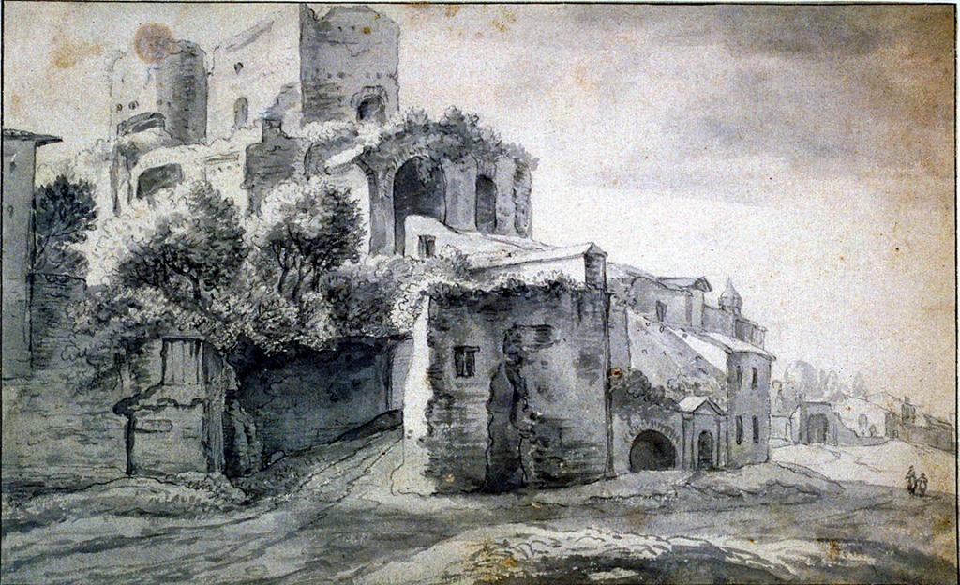
Notes:
Creator: attrib. to Bartholomeus Breenbergh, European; Dutch, 1599 - 1659 Title: Architectural Landscape Work Type: Drawings and Watercolors Date: 16th - 17th century Material: drawing: graphite, brush ink wash Measurements: 19.9 x 32.5 cm (sheet) Repository: Fine Arts Museums of San Francisco Repository: San Francisco, California, USA Repository: Gift of R.E. Lewis Inc. Repository: 1958.117 Repository: http://www.thinker.org/ Collection: Fine Arts Museums of San Francisco Collection Collection: Formerly in The AMICO Library ID Number: FASF.7338 Source: Data From: Fine Arts Museums of San Francisco Rights: This image was provided by Fine Arts Museums of San Francisco. Contact information: Sue Grinols, Director of Photo Services & Imaging, Fine Arts Museums of San Francisco, 50 Hagiwara Tea Garden Drive, Golden Gate Park, San Francisco, CA 94118-4501, (415) 750-3602 (ph), (415) 750-7686 (fax), sgrinols@famsf.org. Rights: Please note that if this image is under copyright, you may need to contact one or more copyright owners for any use that is not permitted under the ARTstor Terms and Conditions of Use or not otherwise permitted by law. While ARTstor tries to update contact information, it cannot guarantee that such information is always accurate. Determining whether those permissions are necessary, and obtaining such permissions, is your sole responsibility.

Slide 11
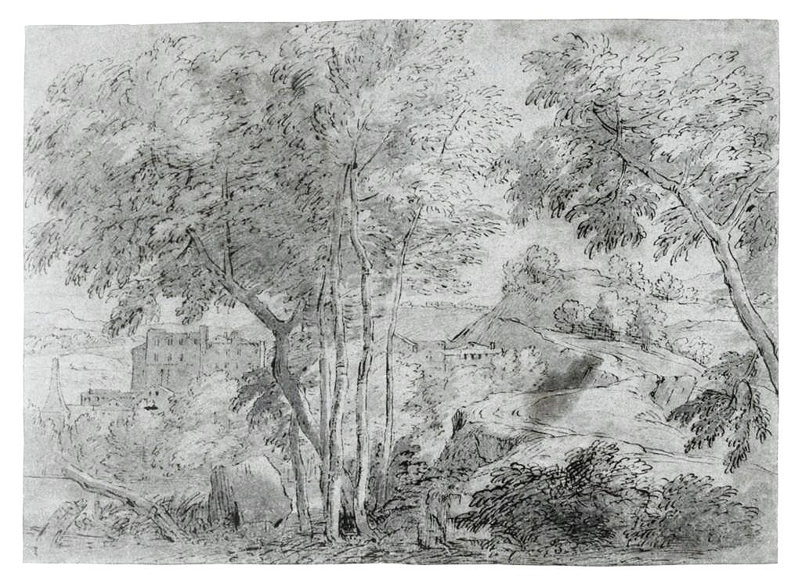
Notes:
Creator: attrib. to Jean-François Millet (Francisque), European; Flemish, 1644 - 1679 Title: Classical Landscape Work Type: Drawings and Watercolors Date: 17th century Material: brown ink and gray wash over black chalk Measurements: 28.1 x 38.8 cm (sheet) Repository: Fine Arts Museums of San Francisco Repository: San Francisco, California, USA Repository: Achenbach Foundation for Graphic Arts purchase, Georges de Batz Collection Repository: 1967.17.90 Repository: http://www.thinker.org/ Collection: Fine Arts Museums of San Francisco Collection Collection: Formerly in The AMICO Library ID Number: FASF.7236 Source: Data From: Fine Arts Museums of San Francisco Rights: This image was provided by Fine Arts Museums of San Francisco. Contact information: Sue Grinols, Director of Photo Services & Imaging, Fine Arts Museums of San Francisco, 50 Hagiwara Tea Garden Drive, Golden Gate Park, San Francisco, CA 94118-4501, (415) 750-3602 (ph), (415) 750-7686 (fax), sgrinols@famsf.org. Rights: Please note that if this image is under copyright, you may need to contact one or more copyright owners for any use that is not permitted under the ARTstor Terms and Conditions of Use or not otherwise permitted by law. While ARTstor tries to update contact information, it cannot guarantee that such information is always accurate. Determining whether those permissions are necessary, and obtaining such permissions, is your sole responsibility.

Slide 12
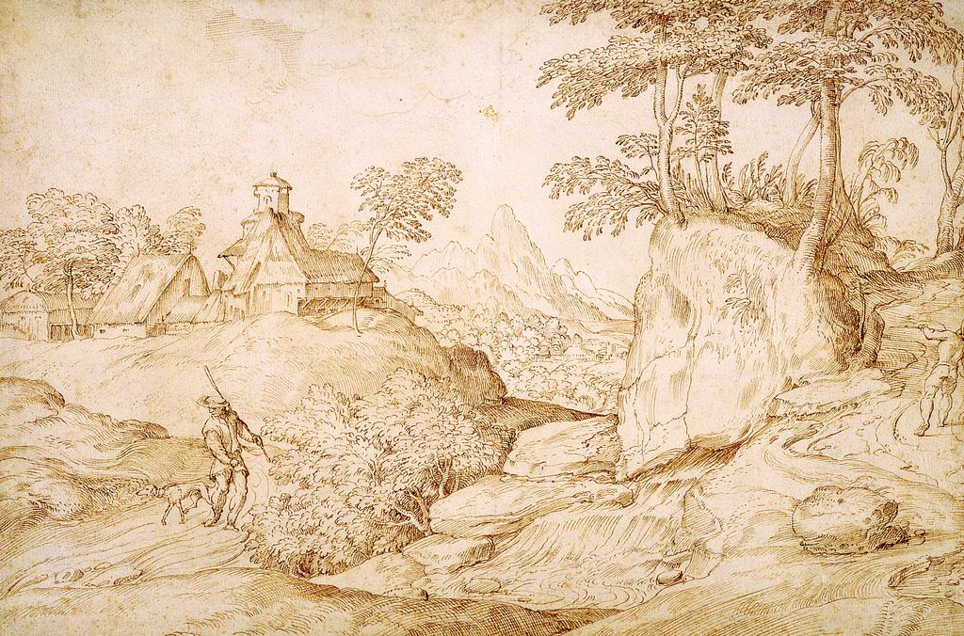
Notes:
Creator: Domenico Campagnola, European; Southern European; Italian, 1500-1564 Title: Two Huntsmen in a Wooded, Rocky Landscape with a Group of Buildings in the Middle Distance Work Type: Drawings and Watercolors Date: c. 1530/1539 Material: Pen and brown ink on cream laid paper Measurements: 25.4 cm x 38.4 cm Description: Full View Repository: The Detroit Institute of Arts Repository: Detroit, Michigan, USA Repository: Gift of Mrs. James E. Scripps Repository: 09.1SDR43 Repository: http://www.dia.org/ Collection: Detroit Institute of Arts Collection Collection: Formerly in The AMICO Library ID Number: DIA_.09.1SDR43 Source: Data from: The Detroit Institute of Arts Rights: This image was provided by The Detroit Institute of Arts. Contact Info for Permissions: Sylvia Inwood, Manager, Rights and Reproduction, The Detroit Institute of Arts, 5200 Woodward Ave., Detroit, MI 48202, 313-833-7913, 313-833-9161, rhensleigh@dia.org Rights: Please note that if this image is under copyright, you may need to contact one or more copyright owners for any use that is not permitted under the ARTstor Terms and Conditions of Use or not otherwise permitted by law. While ARTstor tries to update contact information, it cannot guarantee that such information is always accurate. Determining whether those permissions are necessary, and obtaining such permissions, is your sole responsibility.

Slide 13
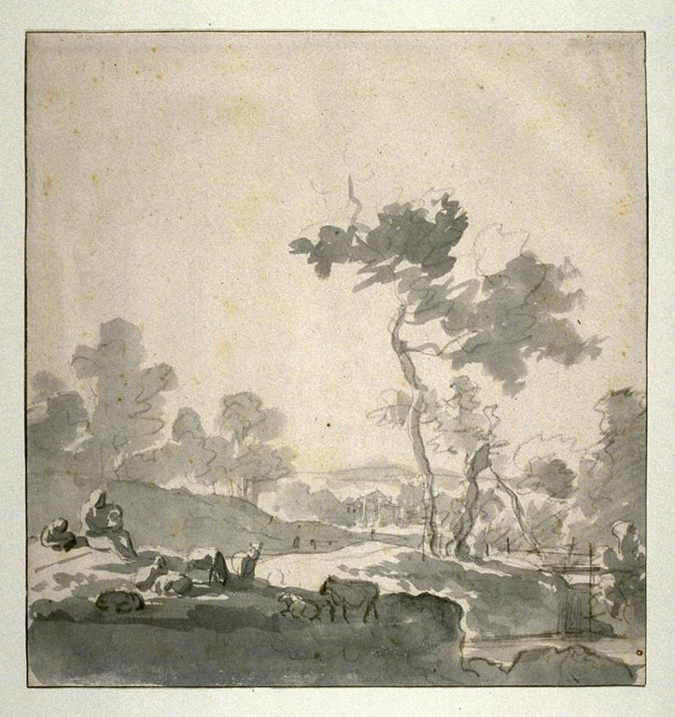
Notes:
Creator: follower of Adriaen van de Velde, European; Dutch, 1636 - 1672 Title: Pastoral Landscape Work Type: Drawings and Watercolors Date: 17th century Material: drawing: crayon and ink wash Measurements: 21.4 x 20.4 cm (sheet) Repository: Fine Arts Museums of San Francisco Repository: San Francisco, California, USA Repository: Achenbach Foundation for Graphic Arts Repository: 1963.24.374 Repository: http://www.thinker.org/ Collection: Fine Arts Museums of San Francisco Collection Collection: Formerly in The AMICO Library ID Number: FASF.7379 Source: Data From: Fine Arts Museums of San Francisco Rights: This image was provided by Fine Arts Museums of San Francisco. Contact information: Sue Grinols, Director of Photo Services & Imaging, Fine Arts Museums of San Francisco, 50 Hagiwara Tea Garden Drive, Golden Gate Park, San Francisco, CA 94118-4501, (415) 750-3602 (ph), (415) 750-7686 (fax), sgrinols@famsf.org. Rights: Please note that if this image is under copyright, you may need to contact one or more copyright owners for any use that is not permitted under the ARTstor Terms and Conditions of Use or not otherwise permitted by law. While ARTstor tries to update contact information, it cannot guarantee that such information is always accurate. Determining whether those permissions are necessary, and obtaining such permissions, is your sole responsibility.

Slide 14
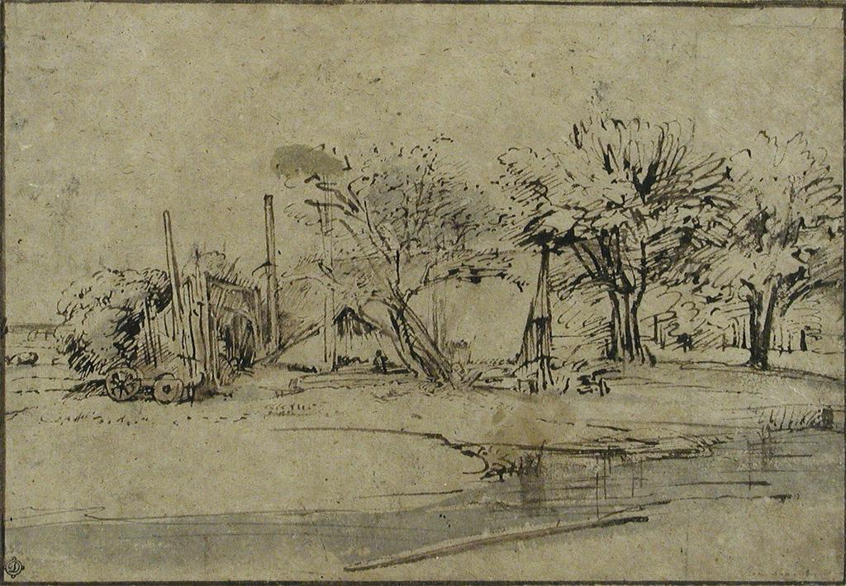
Notes:
Creator: Harmenz. van Rijn Rembrandt, European; Dutch Title: Landscape with Cottage,Trees, and Stream Title: pen and wash landscape drawing Work Type: Drawings and Watercolors Date: c.1606-1659 Material: pen, brown ink, brown and gray wash with brush on paper Measurements: 6 5/16 in. x 9 1/16 in. Description: full view Repository: The Frick Collection Repository: New York, New York, USA Repository: Henry Clay Frick Bequest. Repository: 1913.3.25 Repository: http://www.frick.org/ Collection: The Frick Collection and Art Reference Library Collection Collection: Formerly in The AMICO Library ID Number: TFC_.1913.3.25 Source: Data From: The Frick Collection Rights: This image was provided by The Frick Collection for use in connection with the ARTstor Digital Library. For any uses of this image beyond those permitted in the ARTstor Digital Library License Agreement and the ARTstor Terms and Conditions of Use, please contact Kathrine Gerlough, Head, Retail Sales and Information, The Frick Collection, 1 East 70th Street, New York, NY 10021, (212) 547-0670 (ph), (212) 628-4417 (fax), gerlough@frick.org. You also may need to contact other applicable copyright owners for permission to use this image beyond those permitted in the ARTstor Digital Library License Agreement and the ARTstor Terms and Conditions of Use.

Slide 15
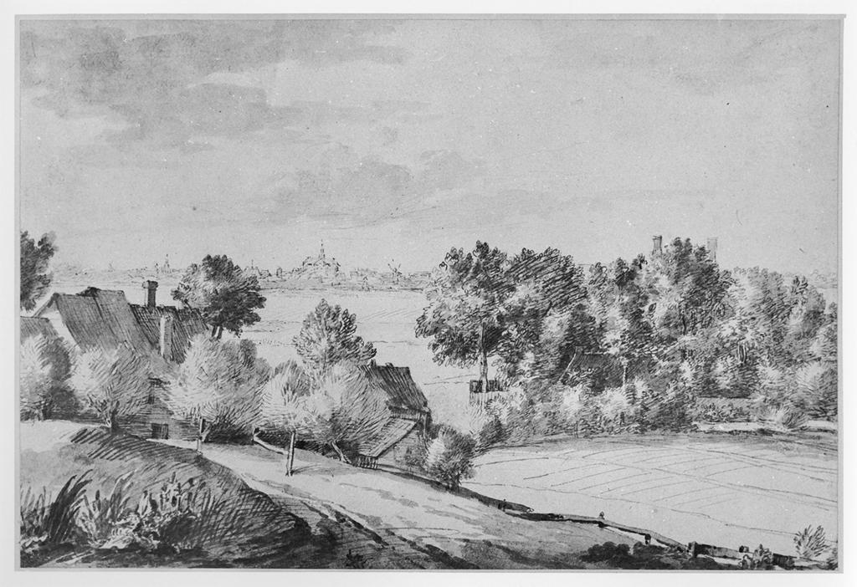
Notes:
Creator: Jan Lievensz. Title: Landscape with houses amid trees in the foreground, and a town in the distance Work Type: drawing Date: mid 17th century Material: pen and brown ink, with gray and brown wash, on paper Measurements: 234 x 350 mm Description: Possibly a view outside Leyden. Repository: British Museum Repository: http://www.britishmuseum.org/ Accession Number: 1876-12-9-628 Collection: Gernsheim Photographic Corpus of Drawings ID Number: 25849 Source: Image and original data provided by the Gernsheim Photographic Corpus of Drawings from photo campaigns that began in 1939 Rights: Please note that if this image is under copyright, you may need to contact one or more copyright owners for any use that is not permitted under the ARTstor Terms and Conditions of Use or not otherwise permitted by law. While ARTstor tries to update contact information, it cannot guarantee that such information is always accurate. Determining whether those permissions are necessary, and obtaining such permissions, is your sole responsibility.

Slide 16
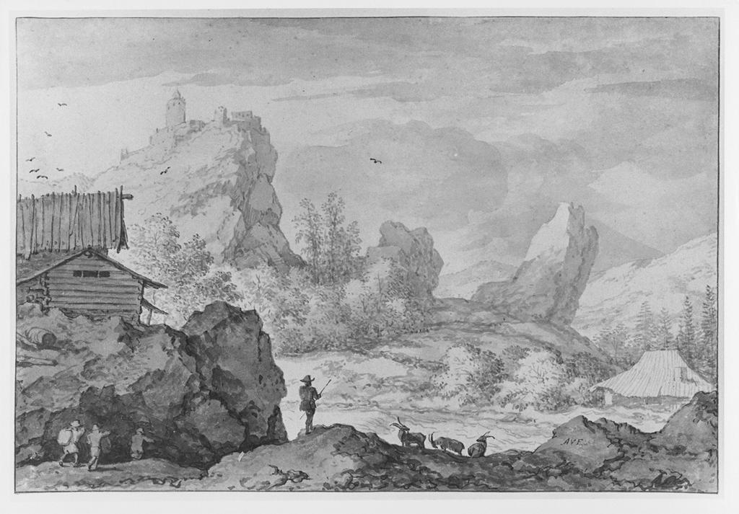
Notes:
Creator: Allart van Everdingen (1621-1675) Title: A mountainous landscape with a river and rapids Date: 1636-1675 Material: brush drawing in brown wash, with pen and brown ink Measurements: 164 x 246 mm Description: Signed with initials Repository: British Museum. Dept. of Prints and Drawings Repository: http://www.britishmuseum.org/ Accession Number: 1836-8-11-177 Collection: Gernsheim Photographic Corpus of Drawings ID Number: 99454 Source: Image and original data provided by the Gernsheim Photographic Corpus of Drawings from photo campaigns that began in 1939 Rights: Please note that if this image is under copyright, you may need to contact one or more copyright owners for any use that is not permitted under the ARTstor Terms and Conditions of Use or not otherwise permitted by law. While ARTstor tries to update contact information, it cannot guarantee that such information is always accurate. Determining whether those permissions are necessary, and obtaining such permissions, is your sole responsibility.

Slide 17
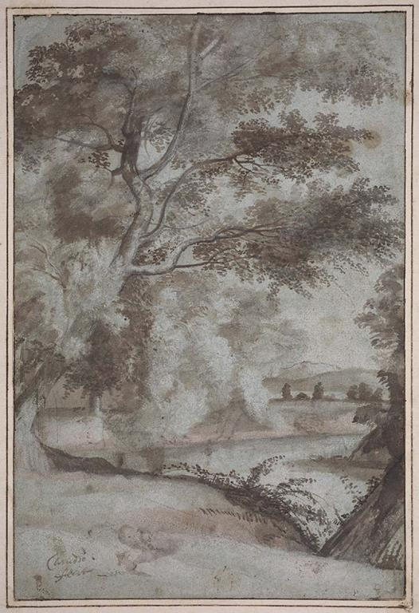
Notes:
Creator: Claude Lorrain Creator: 1600-1682, European; French Title: Landscape Work Type: Drawings and Watercolors Date: 17th century Material: Pen and brown ink with brush and brown and gray wash, touches of graphite pencil, on prepared blue paper Measurements: Sheet: 31.1 x 21.5 cm (12 1/4 x 8 7/16 in.) Description: full view Repository: Museum of Fine Arts, Boston Repository: Boston, Massachusetts, USA Repository: Samuel Putnam Avery Fund Repository: 38.756 Repository: http://www.mfa.org/ Collection: Museum of Fine Arts, Boston, Collection Collection: Formerly in The AMICO Library ID Number: BMFA.38.756 Source: Data From: Museum of Fine Arts, Boston Rights: This image was provided by Museum of Fine Arts, Boston. Contact information: Debra LaKind, Head of Rights & Licensing, Museum of Fine Arts, Boston, 465 Huntington Avenue, Boston, MA 02115, (617) 369-4386 (ph), (617) 369-4340 (fax), dlakind@mfa.org. Rights: Please note that if this image is under copyright, you may need to contact one or more copyright owners for any use that is not permitted under the ARTstor Terms and Conditions of Use or not otherwise permitted by law. While ARTstor tries to update contact information, it cannot guarantee that such information is always accurate. Determining whether those permissions are necessary, and obtaining such permissions, is your sole responsibility.

Slide 18
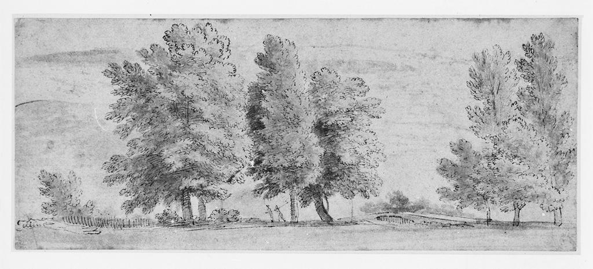
Notes:
Creator: Anthony van Dyck (1599-1641) Title: Landscape with trees and two figures Date: 1614-1632 Material: pen and brown ink, with brown wash and watercolor Measurements: 86 x 212 mm Repository: British Museum. Dept. of Prints and Drawings Repository: http://www.britishmuseum.org/ Accession Number: Gg-2-317 Collection: Gernsheim Photographic Corpus of Drawings ID Number: 25991 Source: Image and original data provided by the Gernsheim Photographic Corpus of Drawings from photo campaigns that began in 1939 Rights: Please note that if this image is under copyright, you may need to contact one or more copyright owners for any use that is not permitted under the ARTstor Terms and Conditions of Use or not otherwise permitted by law. While ARTstor tries to update contact information, it cannot guarantee that such information is always accurate. Determining whether those permissions are necessary, and obtaining such permissions, is your sole responsibility.

Slide 19
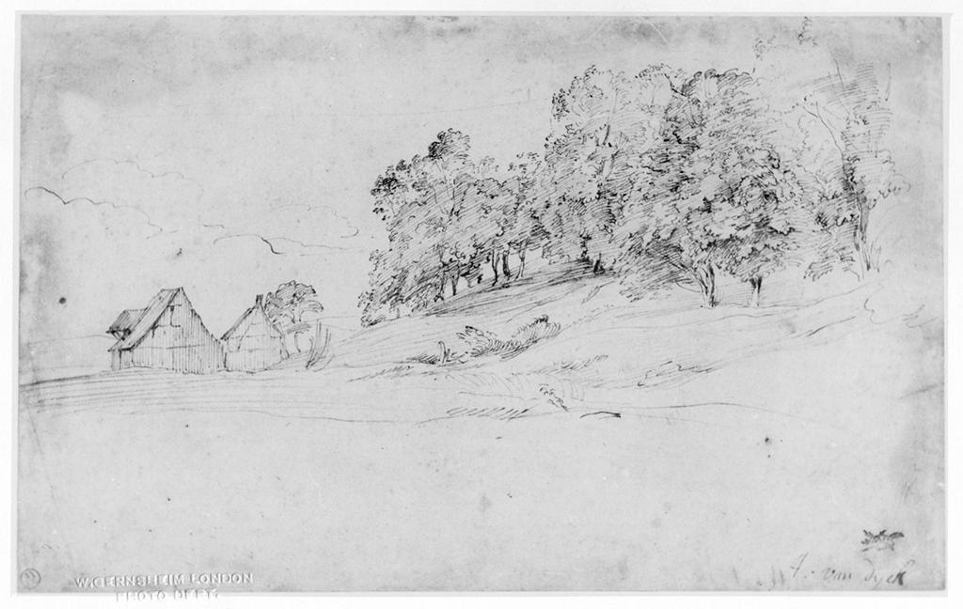
Notes:
Creator: Anthony van Dyck (1599-1641) Title: Cottages and trees on a hillside Date: 1634 Material: pen and brown ink Measurements: 188 x 300 mm Description: Executed in England as were most of van Dyck's landscape drawings. Description: Signed\Verso inscribed: "Monsieur" Repository: British Museum. Dept. of Prints and Drawings Repository: http://www.britishmuseum.org/ Accession Number: 1897-4-10-16 Collection: Gernsheim Photographic Corpus of Drawings ID Number: 5454 Source: Image and original data provided by the Gernsheim Photographic Corpus of Drawings from photo campaigns that began in 1939 Rights: Please note that if this image is under copyright, you may need to contact one or more copyright owners for any use that is not permitted under the ARTstor Terms and Conditions of Use or not otherwise permitted by law. While ARTstor tries to update contact information, it cannot guarantee that such information is always accurate. Determining whether those permissions are necessary, and obtaining such permissions, is your sole responsibility.

Slide 20
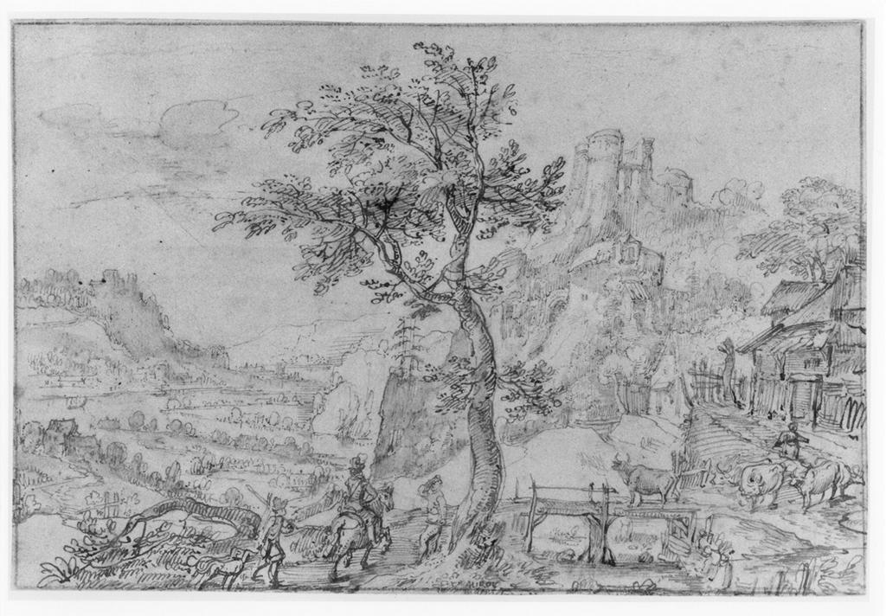
Notes:
Creator: Anthon Mirou Title: Landscape with a castle Work Type: drawing Date: early to mid 17th century Material: pen and brown ink, with gray-brown and blue wash, on paper Measurements: 182 x 270 mm Description: Signed. Repository: British Museum Repository: http://www.britishmuseum.org/ Accession Number: 1983-6-25-1 Collection: Gernsheim Photographic Corpus of Drawings ID Number: 133778 Source: Image and original data provided by the Gernsheim Photographic Corpus of Drawings from photo campaigns that began in 1939 Rights: Please note that if this image is under copyright, you may need to contact one or more copyright owners for any use that is not permitted under the ARTstor Terms and Conditions of Use or not otherwise permitted by law. While ARTstor tries to update contact information, it cannot guarantee that such information is always accurate. Determining whether those permissions are necessary, and obtaining such permissions, is your sole responsibility.

Slide 21
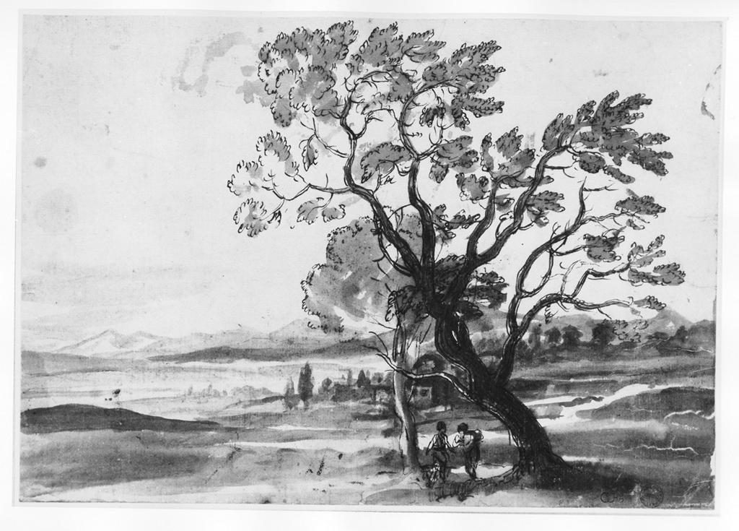
Notes:
Creator: Claude Lorrain Title: Landscape with two Trees Work Type: drawing Date: c. 1638 Material: black chalk with pen and ink, wash on paper Measurements: 216 x 312 mm Repository: Ashmolean Museum Repository: http://www.britishmuseum.org/ Accession Number: WA1855.75 Collection: Gernsheim Photographic Corpus of Drawings Source: Image and original data provided by the Gernsheim Photographic Corpus of Drawings from photo campaigns that began in 1939 Rights: Please note that if this image is under copyright, you may need to contact one or more copyright owners for any use that is not permitted under the ARTstor Terms and Conditions of Use or not otherwise permitted by law. While ARTstor tries to update contact information, it cannot guarantee that such information is always accurate. Determining whether those permissions are necessary, and obtaining such permissions, is your sole responsibility.

Slide 22
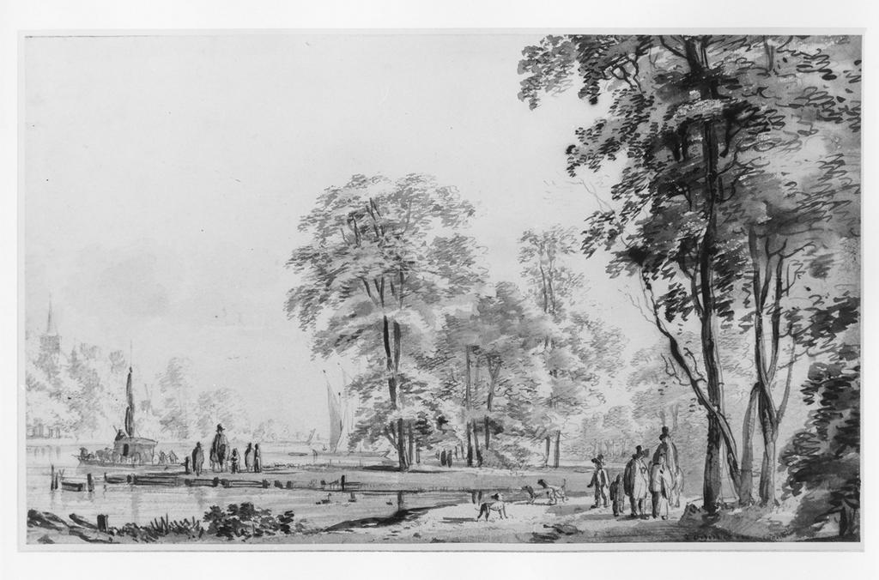
Notes:
Creator: Roelant Roghman Title: Wooded Landscape Work Type: drawing Date: 2nd half 17th Century Material: pen and ink with wash on paper Measurements: 182 x 303 mm Repository: Ashmolean Museum Repository: http://www.britishmuseum.org/ Collection: Gernsheim Photographic Corpus of Drawings Source: Image and original data provided by the Gernsheim Photographic Corpus of Drawings from photo campaigns that began in 1939 Rights: Please note that if this image is under copyright, you may need to contact one or more copyright owners for any use that is not permitted under the ARTstor Terms and Conditions of Use or not otherwise permitted by law. While ARTstor tries to update contact information, it cannot guarantee that such information is always accurate. Determining whether those permissions are necessary, and obtaining such permissions, is your sole responsibility.

Slide 23
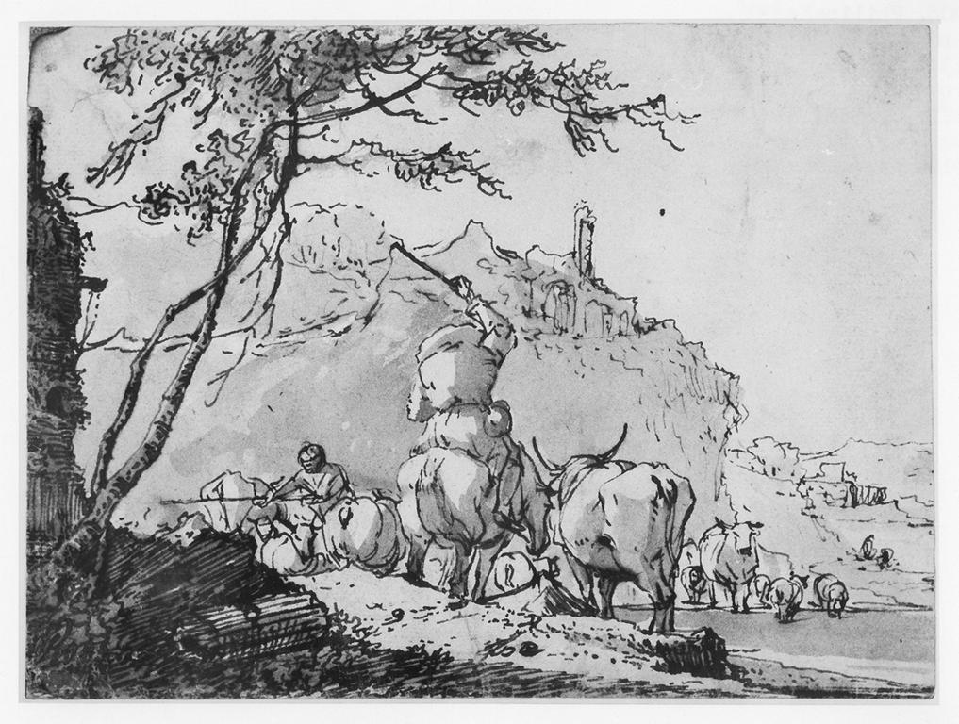
Notes:
Creator: Johann Heinrich Roos Title: Landscape with herdsmen driving cattle Work Type: drawing Date: 1664 Material: pen and brown ink, with gray wash on paper Measurements: 114 x 154 mm Repository: British Museum Repository: http://www.britishmuseum.org/ Accession Number: 1836,0811.461 Collection: Gernsheim Photographic Corpus of Drawings Source: Image and original data provided by the Gernsheim Photographic Corpus of Drawings from photo campaigns that began in 1939 Rights: Please note that if this image is under copyright, you may need to contact one or more copyright owners for any use that is not permitted under the ARTstor Terms and Conditions of Use or not otherwise permitted by law. While ARTstor tries to update contact information, it cannot guarantee that such information is always accurate. Determining whether those permissions are necessary, and obtaining such permissions, is your sole responsibility.

Slide 24
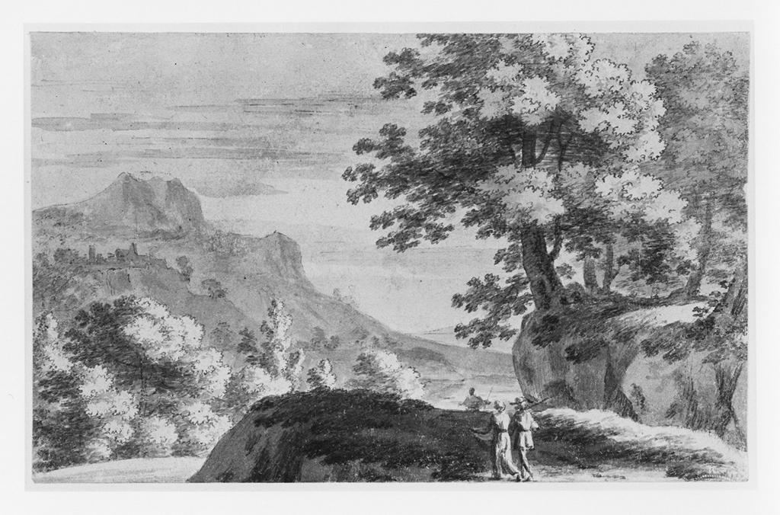
Notes:
Creator: Herman van Swanevelt; attributed to Jacques Rousseau Title: Italian landscape with two figures on a road Work Type: drawing Date: 17th Century Material: pen and brown ink and gray wash on paper Measurements: 97 x 157 mm Repository: British Museum Repository: http://www.britishmuseum.org/ Accession Number: Gg,2.275 Collection: Gernsheim Photographic Corpus of Drawings Source: Image and original data provided by the Gernsheim Photographic Corpus of Drawings from photo campaigns that began in 1939 Rights: Please note that if this image is under copyright, you may need to contact one or more copyright owners for any use that is not permitted under the ARTstor Terms and Conditions of Use or not otherwise permitted by law. While ARTstor tries to update contact information, it cannot guarantee that such information is always accurate. Determining whether those permissions are necessary, and obtaining such permissions, is your sole responsibility.

Slide 25
Thank you!
Any Questions?

